Slide 1
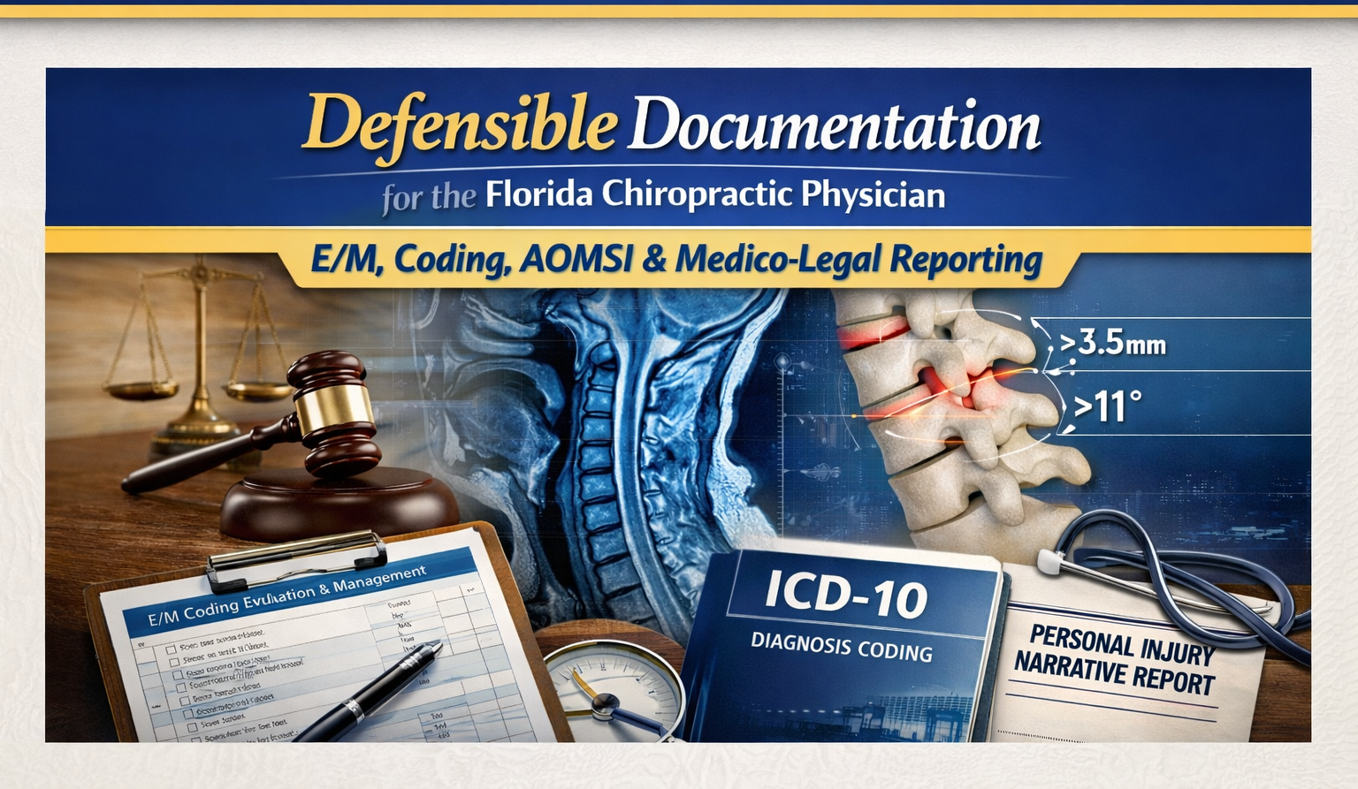

Slide 2
Biographical Information
1997 Graduate of National University of Health Sciences
Director of Fellowship in Spine Management
Co-Director of Spine Management Program at Catholic Health Partners
  Paul McBride MD – University of Buffalo Neurosurgery
Private Practice – Buffalo, NY
Florida Chiropractic Association –2026

Slide 3
Conference Agenda
I. Florida Documentation Standards
II. E/M Documentation
III. Musculoskeletal Diagnosis Coding
IV. MRI Documentation & AOMSI
V. Personal Injury Narrative Reporting
VI. Complex Case Documentation
VII. Clinical Implementation
Florida Chiropractic Association – 2026

Slide 4

Florida Documentation Standards
Florida Board of Chiropractic Medicine
Record retention requirements
Required documentation elements
Treatment plan requirements
Florida Chiropractic Association – 2026

Slide 5

Florida Chiropractic Documentation
Compliance Checklist
At a glance
Slide version for class attendees • built around Florida Board record expectations and CPT medical-necessity support
• Initial record elements
• Daily visit SOAP-style support
• Progress evaluation checkpoints
• Record integrity and signatures
• Billing and retention rules
• Common Florida audit risks
Use this deck to audit charts for initial visits, daily notes, reassessments, billing support, and record-retention compliance.
Notes:
[Sources]
- Florida Administrative Code Rule 64B2-17.0065 (minimum chiropractic medical-record requirements)
- Florida Administrative Code Rule 64B2-17.006 (record retention and patient notification)
- Florida Statutes § 460.41 (itemized patient billing)
- Florida Board of Chiropractic Medicine renewal page (documentation / record-keeping continuing-education requirement)
[/Sources]

Slide 6
Florida Rules vs. CPT Guidelines
Florida requires chart content that supports both legal record compliance and billing support.
CPT / payer focus
Florida Board / legal focus
☐ Medical necessity for each billed service
☐ Documentation that supports the code selected
☐ Procedure detail, body region, and service rationale
☐ Time or complexity when the code requires it
☐ History, symptomatology, exam findings, diagnosis, prognosis, assessment, treatment plan, and treatment rendered
☐ Daily record entries dated with provider identity
☐ Late entries clearly marked as late entries
☐ Retention and release obligations governed by state rule and statute
Bottom line: a chart may be billable yet still fall short of Florida Board record standards if required clinical elements are missing.
Notes:
[Sources]
- Florida Administrative Code Rule 64B2-17.0065
- Florida Statutes Chapter 460
[/Sources]

Slide 7
Initial Visit Checklist
The first encounter should establish medical necessity, clinical reasoning, and the treatment plan.
History
Examination
Clinical determination
☐ Chief complaint
☐ Mechanism of injury or onset
☐ History of present illness
☐ Relevant past medical history
☐ Medication list when applicable
☐ Review of systems when clinically appropriate
☐ Orthopedic findings
☐ Neurological findings when indicated
☐ Range-of-motion assessment
☐ Palpatory findings
☐ Functional limitations
☐ Imaging only when medically or clinically indicated
☐ Diagnosis or clinical impression
☐ Prognosis documented
☐ Assessment of current status
☐ Goals of care
☐ Visit frequency and expected duration
☐ Specific procedures planned and reassessment / discharge criteria
Notes:
[Sources]
- Florida Administrative Code Rule 64B2-17.0065(4)
[/Sources]

Slide 8
Daily Visit & Treatment Documentation
Once a treatment plan is in place, each visit should show what changed, what was found, and what was done.
Daily note essentials
Procedure support
Avoid weak notes
☐ Subjective complaint or interval update
☐ Objective findings relevant to that visit
☐ Assessment of progress or current status
☐ Treatment provided
☐ Manipulated region documented
☐ Adjunctive procedures identified
☐ Anatomical area treated
☐ Treatment response noted
☐ Clinical rationale ties back to findings
☐ Do not clone identical entries across visits
☐ Do not rely on pain scores alone
☐ Do not omit objective findings
☐ Do not leave the next-step plan unclear
SOAP format works well in Florida because it naturally captures the required daily record elements.
Notes:
[Sources]
- Florida Administrative Code Rule 64B2-17.0065(6)
[/Sources]

Slide 9
Reassessment, Record Integrity, and Signatures
Auditors look for progress checkpoints and legally reliable entries.
Progress evaluation
Record integrity
Provider identification
☐ Progress toward treatment goals
☐ Functional change documented
☐ Updated objective findings
☐ Modification of treatment plan when needed
☐ Decision for continued care vs. discharge
☐ Every entry accurately dated
☐ Corrections made transparently
☐ Late entries labeled as late entries
☐ No blank spaces or unexplained alterations
☐ Abbreviation key available if symbols are used
☐ Treating physician readily identifiable
☐ Signature, initials, or printed/electronic name present
☐ Multi-provider offices should clearly attribute each service
☐ Delegated tasks should still leave the treating physician clear
Notes:
[Sources]
- Florida Administrative Code Rule 64B2-17.0065(5)
- Florida Administrative Code Rule 64B2-17.0065(6)
[/Sources]

Slide 10
Billing, Retention, and Frequent Florida Audit Risks
A strong chart supports both reimbursement and Board review.
Billing support
Retention
Common audit deficiencies
☐ Each billed service corresponds to charted treatment
☐ Diagnosis supports the service rendered
☐ Itemized statement available when requested
☐ Documentation supports medical necessity
☐ Retain records at least 4 years from last visit
☐ Protect confidentiality in storage and destruction
☐ Follow notice procedures for practice closure or relocation
☐ Missing treatment plan
☐ No objective findings
☐ No progress assessment
☐ Identical daily notes
☐ Missing provider identification
☐ Weak medical-necessity support
Notes:
[Sources]
- Florida Administrative Code Rule 64B2-17.006
- Florida Statutes § 460.41
[/Sources]

Slide 11
Quick Self-Audit for Class Attendees
If these questions are clearly answered in the record, the chart is usually on stronger footing.
Five-chart questions
Practical reminder
☐ Why was care necessary today?
☐ Which findings supported treatment today?
☐ What exact treatment or procedure was performed?
☐ How did the patient respond or progress?
☐ What is the next-step plan?
☐ Florida compliance is not just coding compliance
☐ The treatment plan and daily objective findings matter
☐ Good records should be readable by an outside reviewer without explanation
Questions or follow-up: wowens@nationalspinemanagement.com • Text 716-228-3847 • Schedule time: https://bit.ly/47XtW6C
Notes:
[Sources]
- Florida Administrative Code Rule 64B2-17.0065
- Florida Administrative Code Rule 64B2-17.006
- Florida Statutes § 460.41
[/Sources]

Slide 12




Slide 13
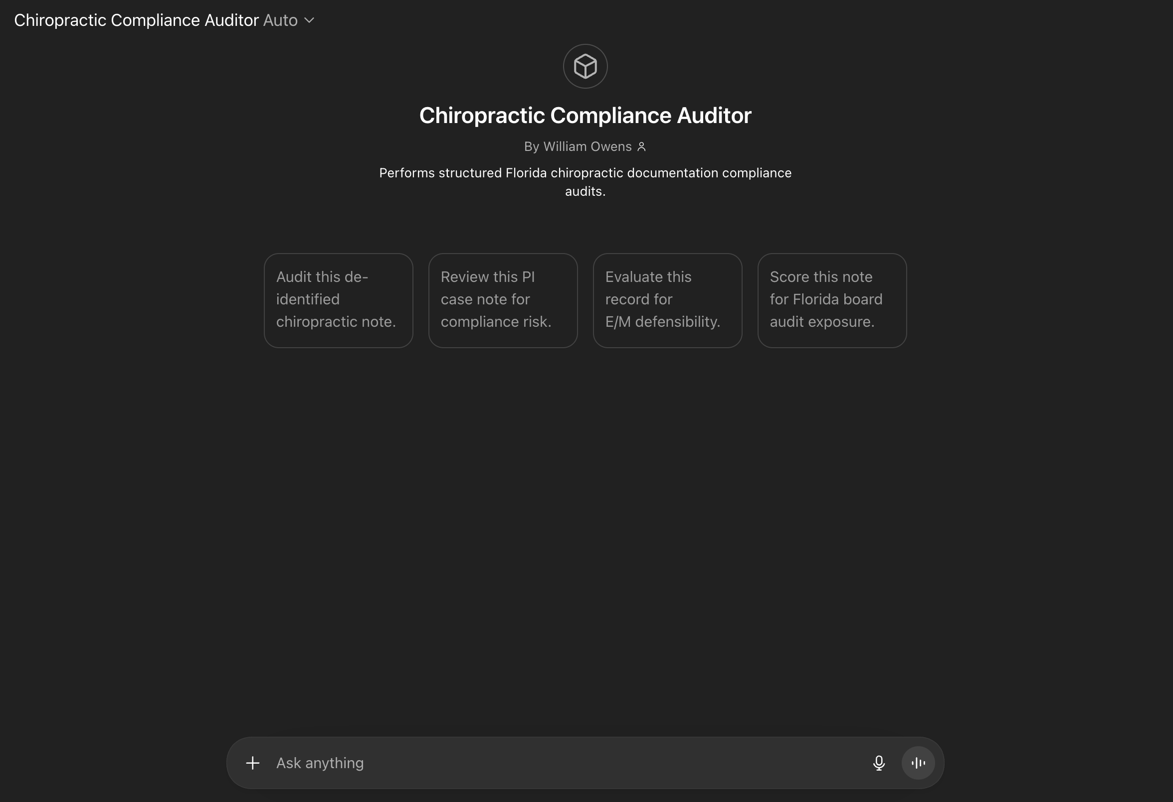

Slide 14


Slide 15
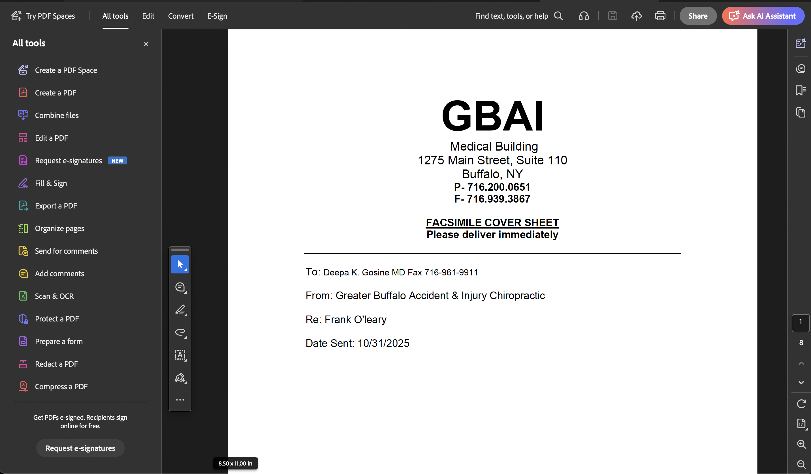


Slide 16
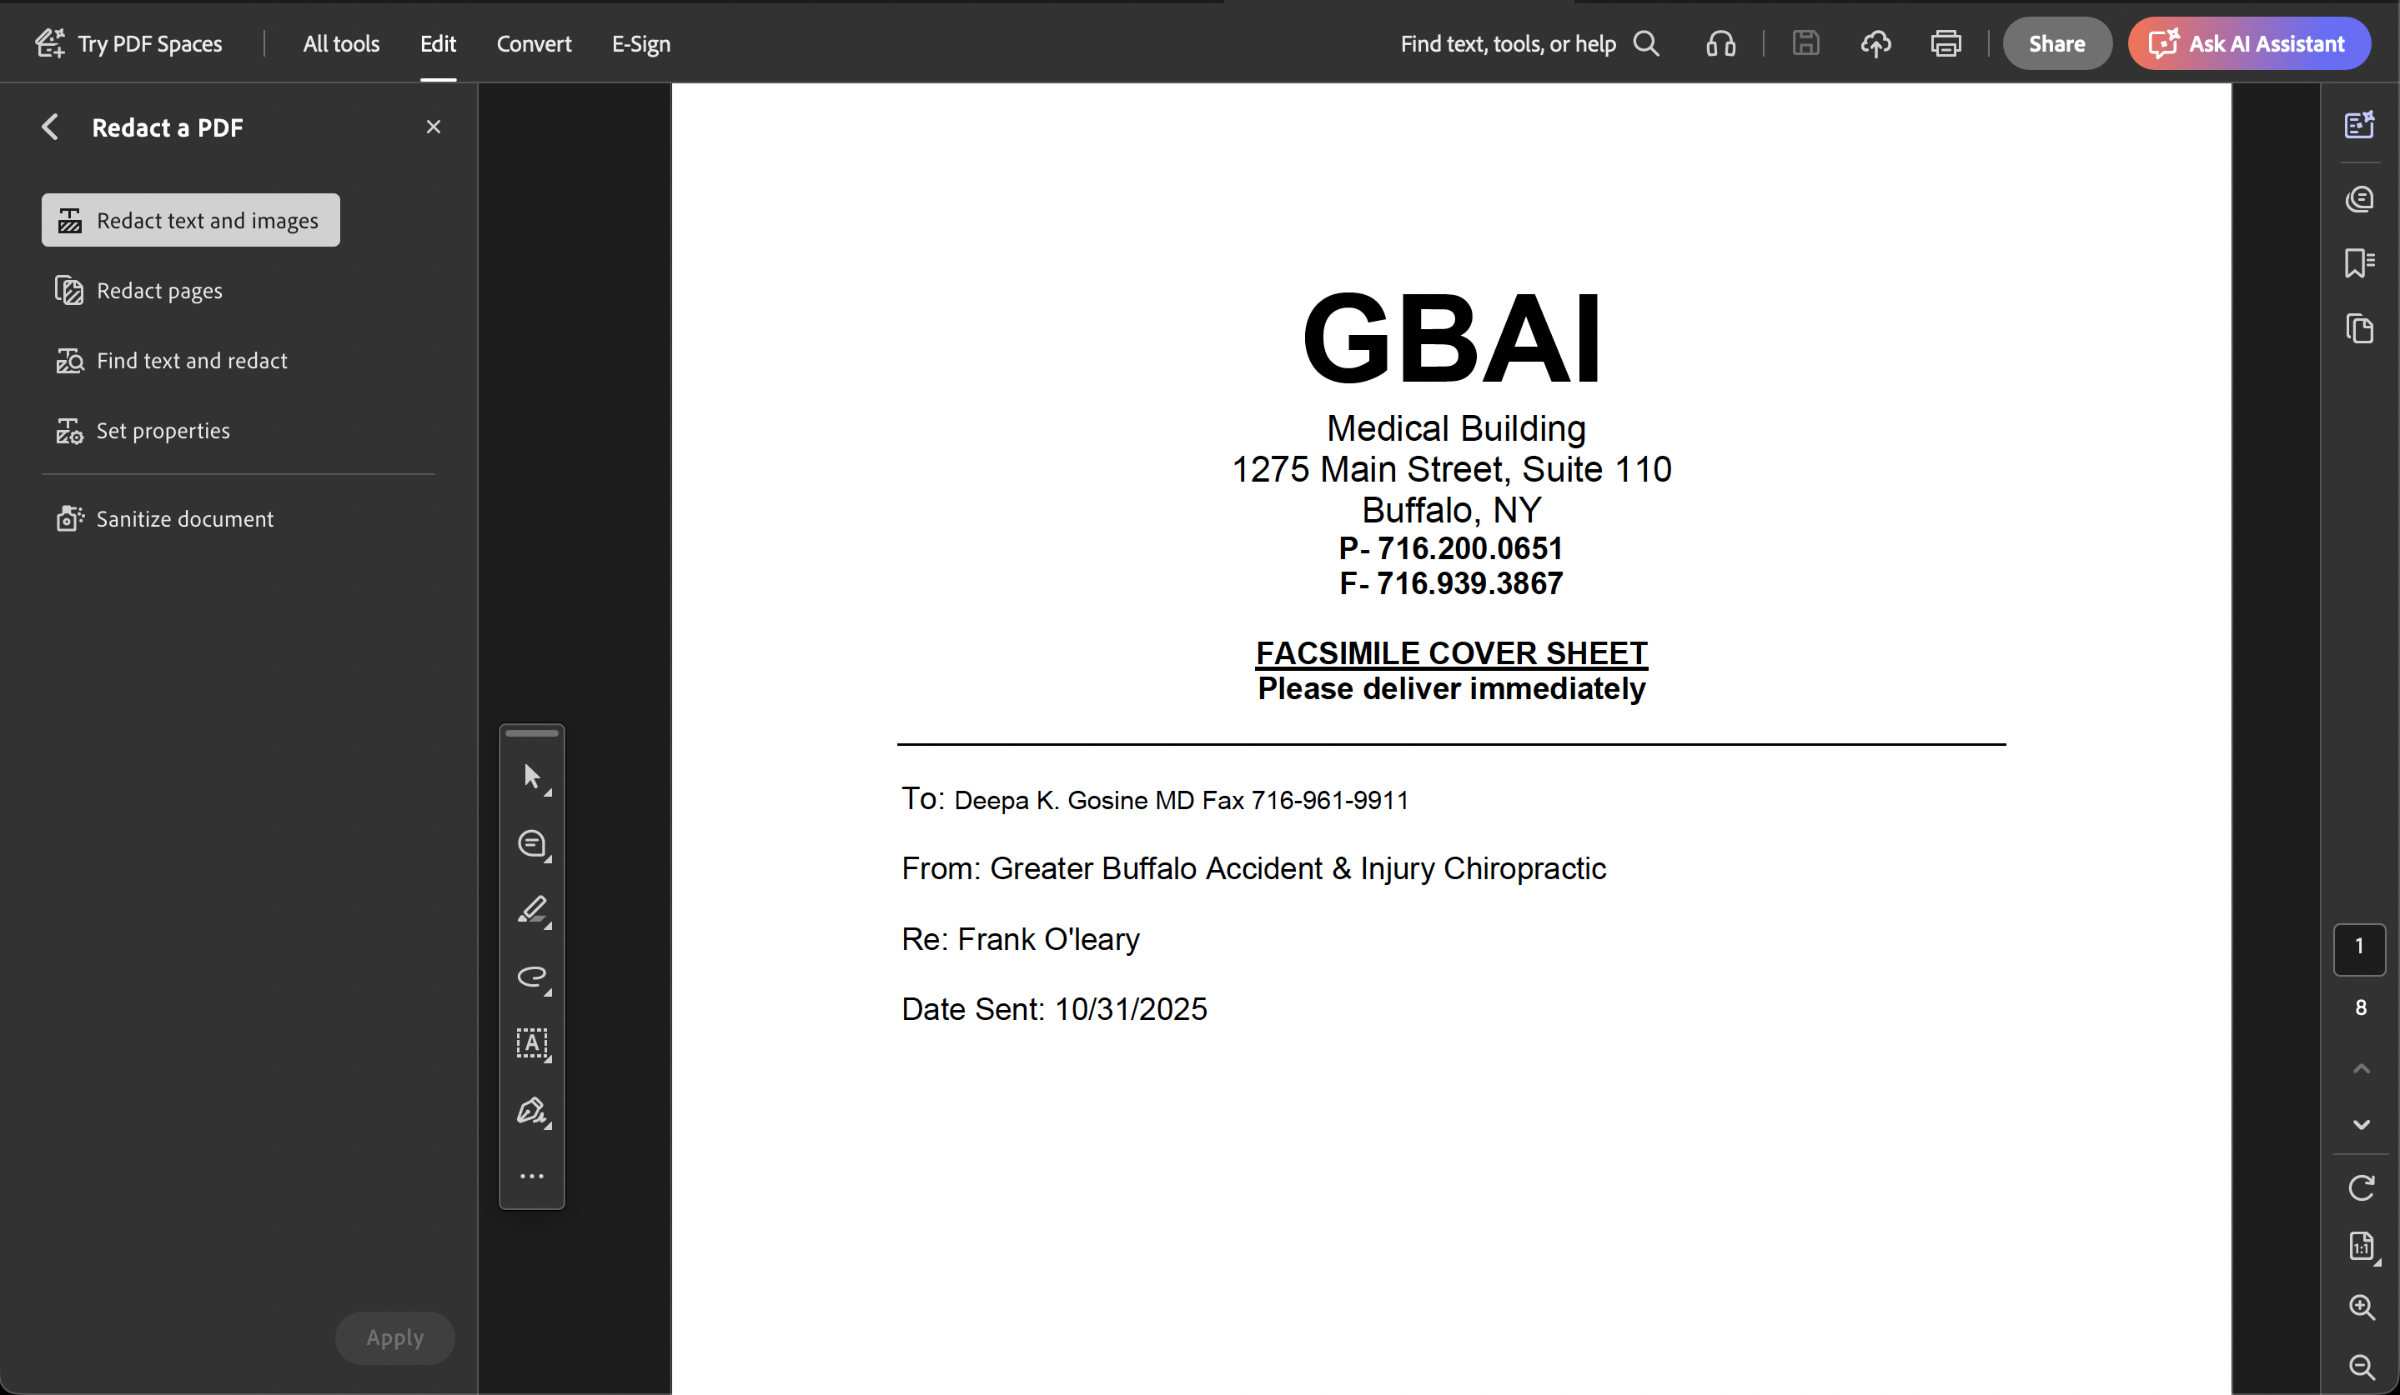

Slide 17
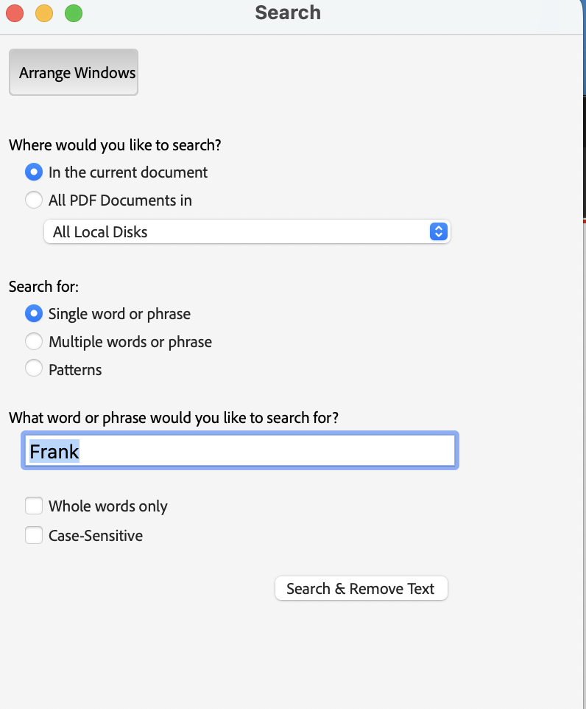

Slide 18
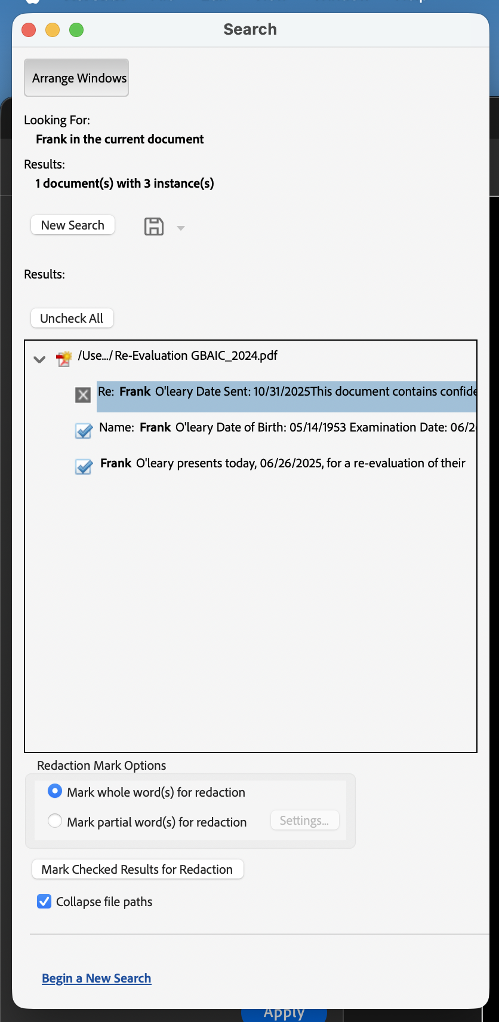

Slide 19

Risk Management
Audit triggers – use AI to help you – NOT LEGAL ADVICE
  Predatory lawyers – billable hours
Documentation vs billing mismatch
Clinical notes vs medico‑legal documentation
Medical necessity must be supported
Florida Chiropractic Association – 2026

Slide 20
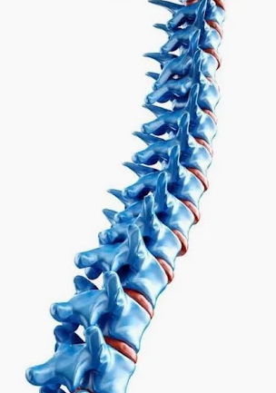
Documentation vs billing mismatch
Each spinal or extra-spinal region needs the following
Subjective Finding
Objective Evidence (subluxation/fixation)
A Diagnosis
Treatment Plan
Florida Chiropractic Association – 2026

Slide 21

Clinical notes vs medico‑legal documentation
Clinical notes are NOT medico-legal documentation. Medico-legal documentation
Requires additional evidence to support the legal claim.
Causality
Demonstrative Bodily Injury
Initial Functional Loss
Persistent Functional Loss
Florida Chiropractic Association – 2026

Slide 22
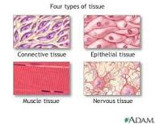
Case Management 101 – The Issue is in the Tissue
Personal injury care begins with identifying the injured tissue
Clinical decisions must align with tissue pathology
Documentation must support both care and legal scrutiny
Emphasis is on injury pattern recognition and defensibility

Slide 23
Tissue Classification in Personal Injury
Ligamentous injury – instability, delayed healing
Discal injury – annular disruption, herniation, endplate changes
Muscular injury – strain patterns, recovery expectations
Osseous injury – fractures, contusions, structural compromise

Slide 24

The PILLARS of CASE MANAGEMENT

Slide 25

Patient History
Mechanism of Injury
Location of Symptoms
Pattern of Symptoms
Correlation with Tissue Injury
Correlation with Prior Injuries/ Symptoms
Gap in Care
Gap in Future Care

Slide 26

Physical Examination
Range of Motion
Spasm vs Contraction
Neurological Testing
Orthopedic Testing

Slide 27

“Day Of” X-Rays
Arthritis
Osteophytes
Bone Spurs
Degenerative Changes

Slide 28

MRI
Herniation vs Bulge
Desiccation
Lost of Disc Height
Osteophytes/Enthesophytes
Loss of Disc Signal
Modic Changes

Slide 29
Special Testing
Dynamic X-Rays – AOMSI
EMG
EEG/Concussion Testing

Slide 30
Evaluation & Management Documentation
2021+ AMA E/M guidelines
Medical Decision-Making framework
Problem complexity
Data/testing reviewed
Florida Chiropractic Association – 2026

Slide 31
Updated E/M Coding Criteria
Chiropractic Clinical Documentation Framework
(Florida Chiropractic Practice Standards)
Understanding updated Evaluation and Management coding
Focus on Medical Decision Making and Time-Based reporting
Applicable to chiropractic clinical documentation

Slide 32
Core Change (2021–Present)
E/M levels are determined primarily by:
1. Medical Decision Making (MDM)
2. Total Time on the Date of Encounter
  History and physical exam remain medically appropriate
  History and exam no longer determine code level
  Requires a TIME STAMP – not 10 min – 10:43 is better

Slide 33
Medical Decision Making (MDM) Components
1. Number & Complexity of Problems Addressed
  Acute uncomplicated spinal conditions
  Exacerbation of chronic spinal disorders
  Traumatic musculoskeletal injuries
  Neurological findings or radiculopathy

Slide 34
MDM Components: Data Reviewed
2. Data Reviewed and Analyzed
  Imaging review (MRI, CT, X‑ray)
  Radiology reports
  Prior clinical records
  Diagnostic testing interpretation

Slide 35
MDM Components: Risk Assessment
3. Risk of Complications or Morbidity
  Treatment decisions
  Referral decisions
  Imaging utilization
  Co-management with other providers

Slide 36

Time-Based Coding Option
Total Time Includes:
  Chart review
  Patient evaluation
  Documentation
  Care coordination
  Patient counseling
REQUIRES A TIME STAMP

Slide 37
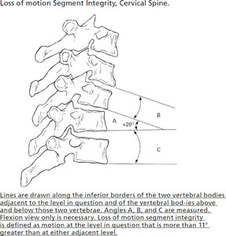
CPT 99358 – Prolonged Evaluation and Management Service
Understanding prolonged non-face-to-face services
Applicable to physicians and qualified healthcare professionals
Documentation must support time and medical necessity

Slide 38
Definition of CPT 99358
Prolonged evaluation and management service before and/or after
direct patient care
Represents the first hour of prolonged service
Service occurs outside of the face-to-face patient encounter
IDEAL for IMAGING REVIEWS and AOMSI services

Slide 39
Key Characteristics of CPT 99358
Non-face-to-face service
Performed by a physician or qualified healthcare professional
Time-based code requiring documentation of prolonged work
Must relate to an existing or upcoming patient encounter

Slide 40

Examples of Work That May Qualify
Extensive medical record review
Review and interpretation of diagnostic imaging or reports
Care coordination with other providers
Complex case documentation preparation

Slide 41

Documentation Considerations
Document total time spent on prolonged services
Identify the clinical purpose of the review or coordination
Link the work performed to patient management
Maintain clear records supporting medical necessity

Slide 42

Musculoskeletal Diagnosis Coding
ICD‑10‑CM structure
Link diagnosis to objective findings
Laterality requirements – right or left
Mechanism of injury documentation
Florida Chiropractic Association – 2026

Slide 43

Common Coding Errors
Bone
Nerve
Ligament
Disc
Muscle
Overuse of M54.5
Missing neurologic correlation
Poor imaging correlation
Missing causal statements
Florida Chiropractic Association – 2026

Slide 44
Intervertebral Disc Herniation Coding
M Code – Degenerative Disc Herniation
M51.26 – Other intervertebral disc displacement, lumbar region
Represents degenerative or non‑traumatic disc herniation
Common in routine spine care
No external injury required
Located in ICD‑10 Chapter 13 (Musculoskeletal Diseases)
S Code – Traumatic Disc Herniation
S33.0XXA – Traumatic rupture of lumbar intervertebral disc
Represents disc injury caused by trauma
Common in motor vehicle collision and fall injuries. Requires 7th character encounter designation
Located in ICD‑10 Chapter 19 (Injury Codes)

Slide 45
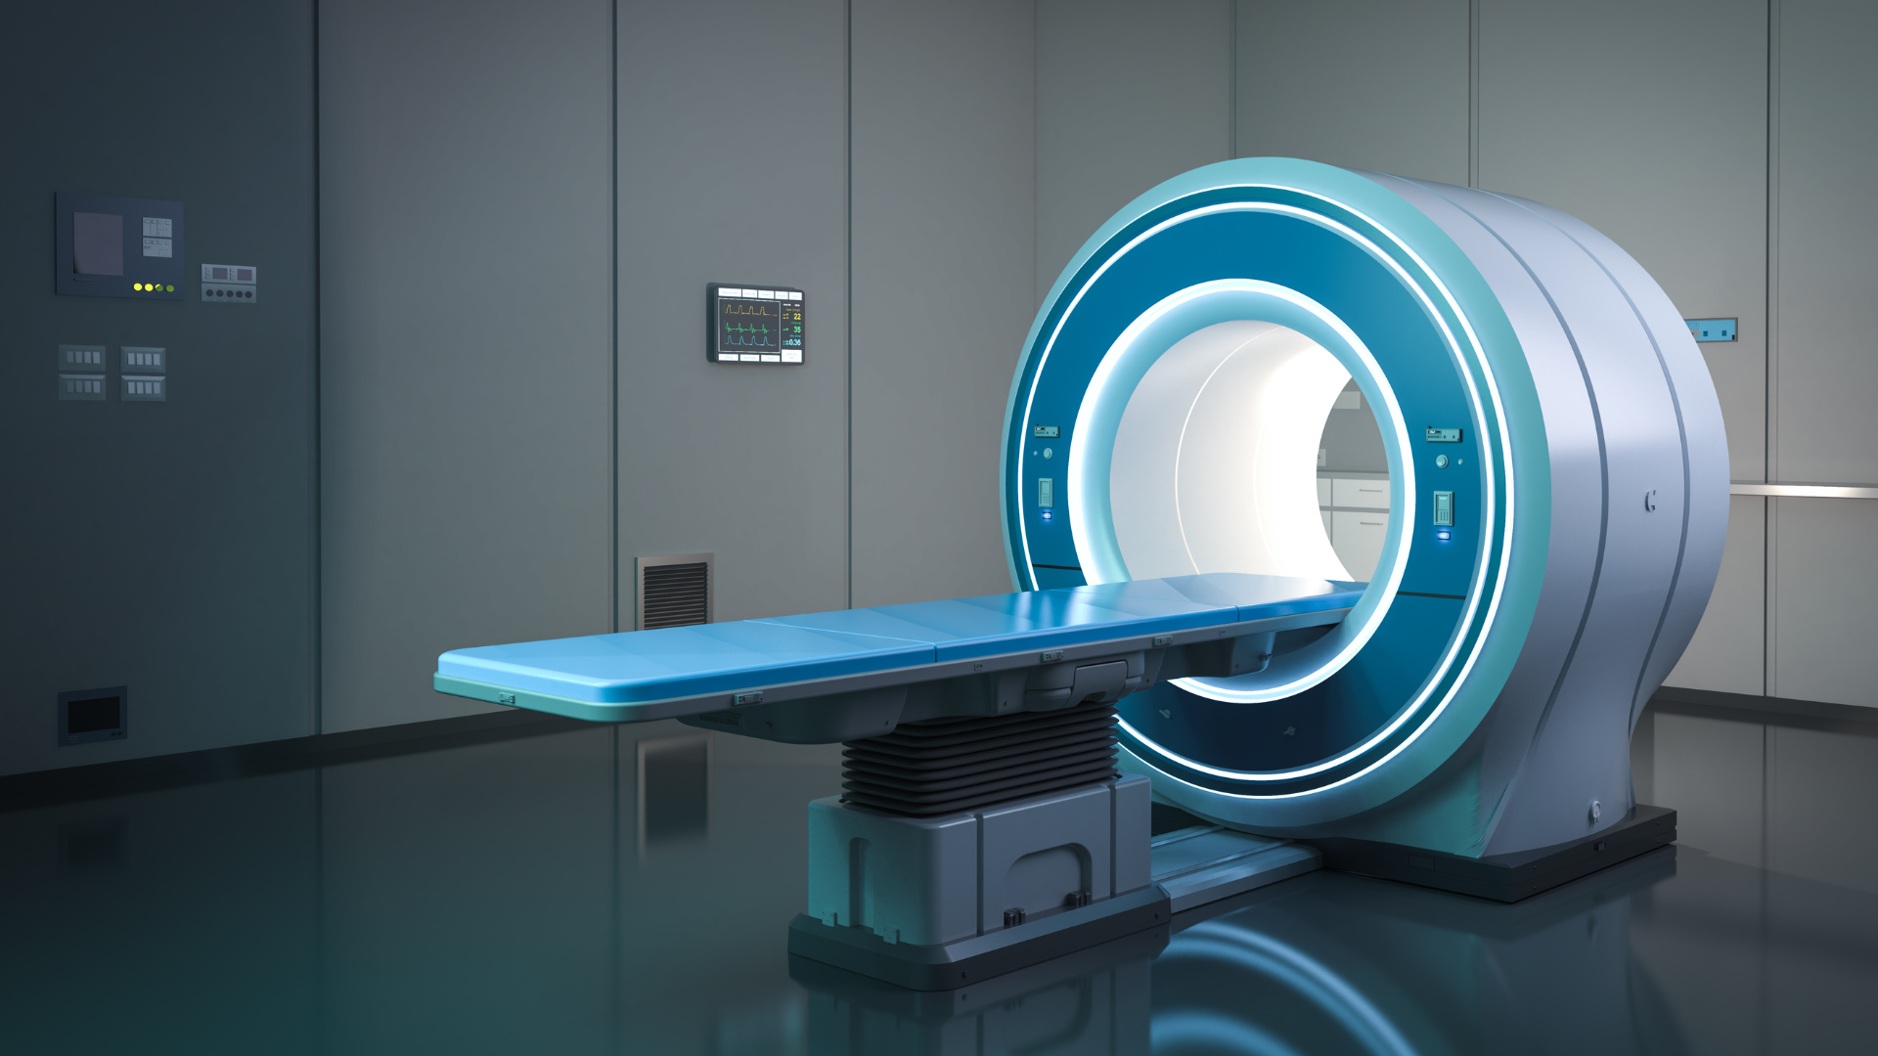
MRI Documentation Standards
Disc morphology terminology
Related to annular fissues
Herniation – radial fissure
Bulge – circumferential
Level and laterality documentation
Exiting spinal nerve
Traversing spinal nerve – caudia equina
Osteophyte positioning
Correlation vs incidental findings
Ligament/Disc – what is the pain generator?
Florida Chiropractic Association – 2026

Slide 46
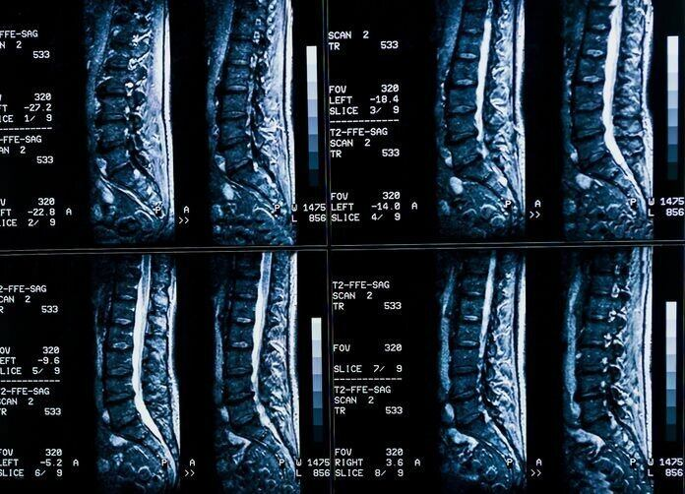
What is the ABCDE Method?
A – Alignment
B – Bone
C – Cord
D – Intervertebral Disc
E – Everything Else

Slide 47
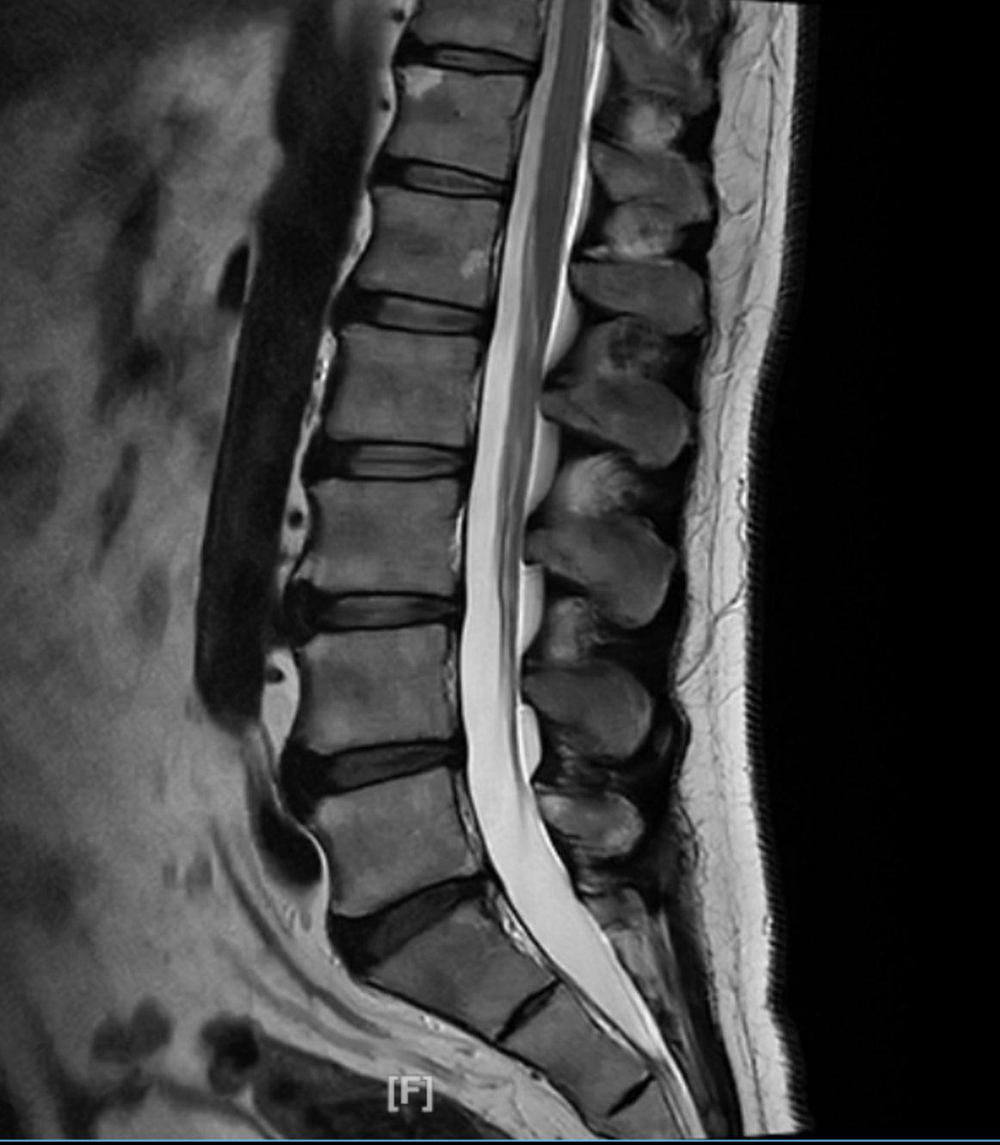

Slide 48

A – Alignment
Listhesis
Rotation
Kyphosis/Lordosis
Break in Georges Line

Slide 49
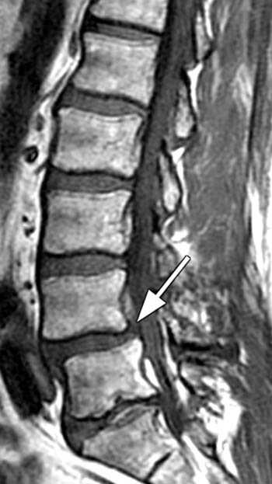

Slide 50

B – Bone
Fracture
Tumor
Modic Changes
Marrow Signal
Osteophytes
Enthesophytes

Slide 51
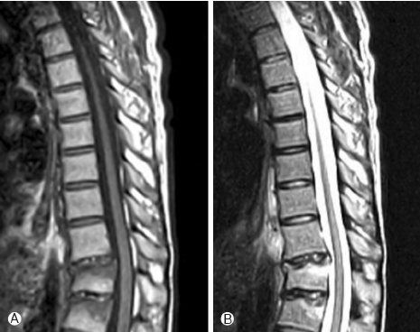

Slide 52

C - Cord
Abutment
Compression
Syrinx
Myelomalacia
Arachnoiditis (not cord)
Caudia Equina (not cord)

Slide 53
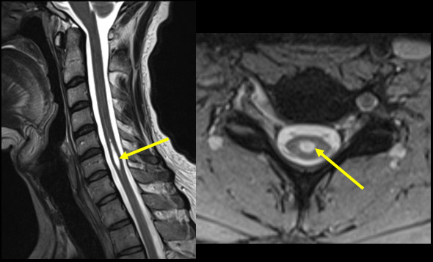

Slide 55

D - Disc
Desiccation
Bulge
Herniation
  Protrusion
  Extrusion
  Sequestration
Annular Fissures
Vacuum Sign
Osteophytes (see B – Bone)

Slide 56
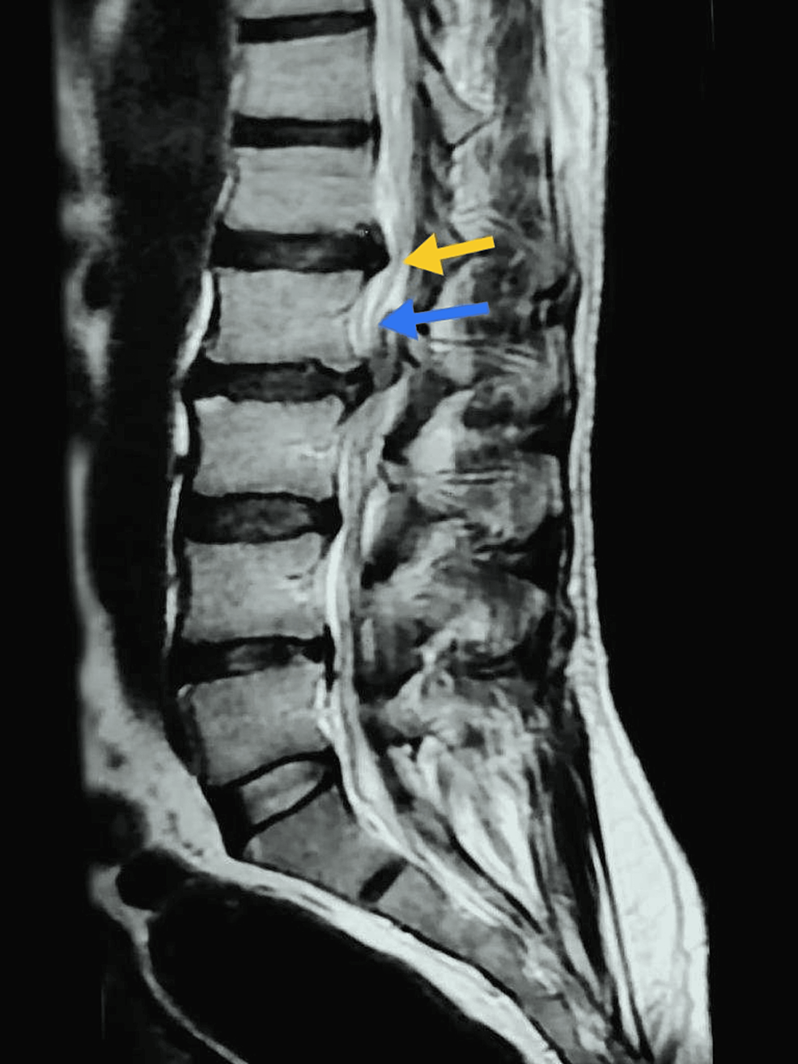

Slide 58

E – Everything Else
Ligament
Nerve
Muscle
Fat
Arteries
  Aorta
  Vertebral
  Carotid
Viscera

Slide 59
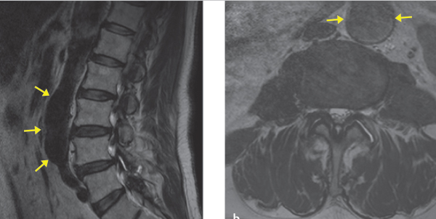

Slide 60
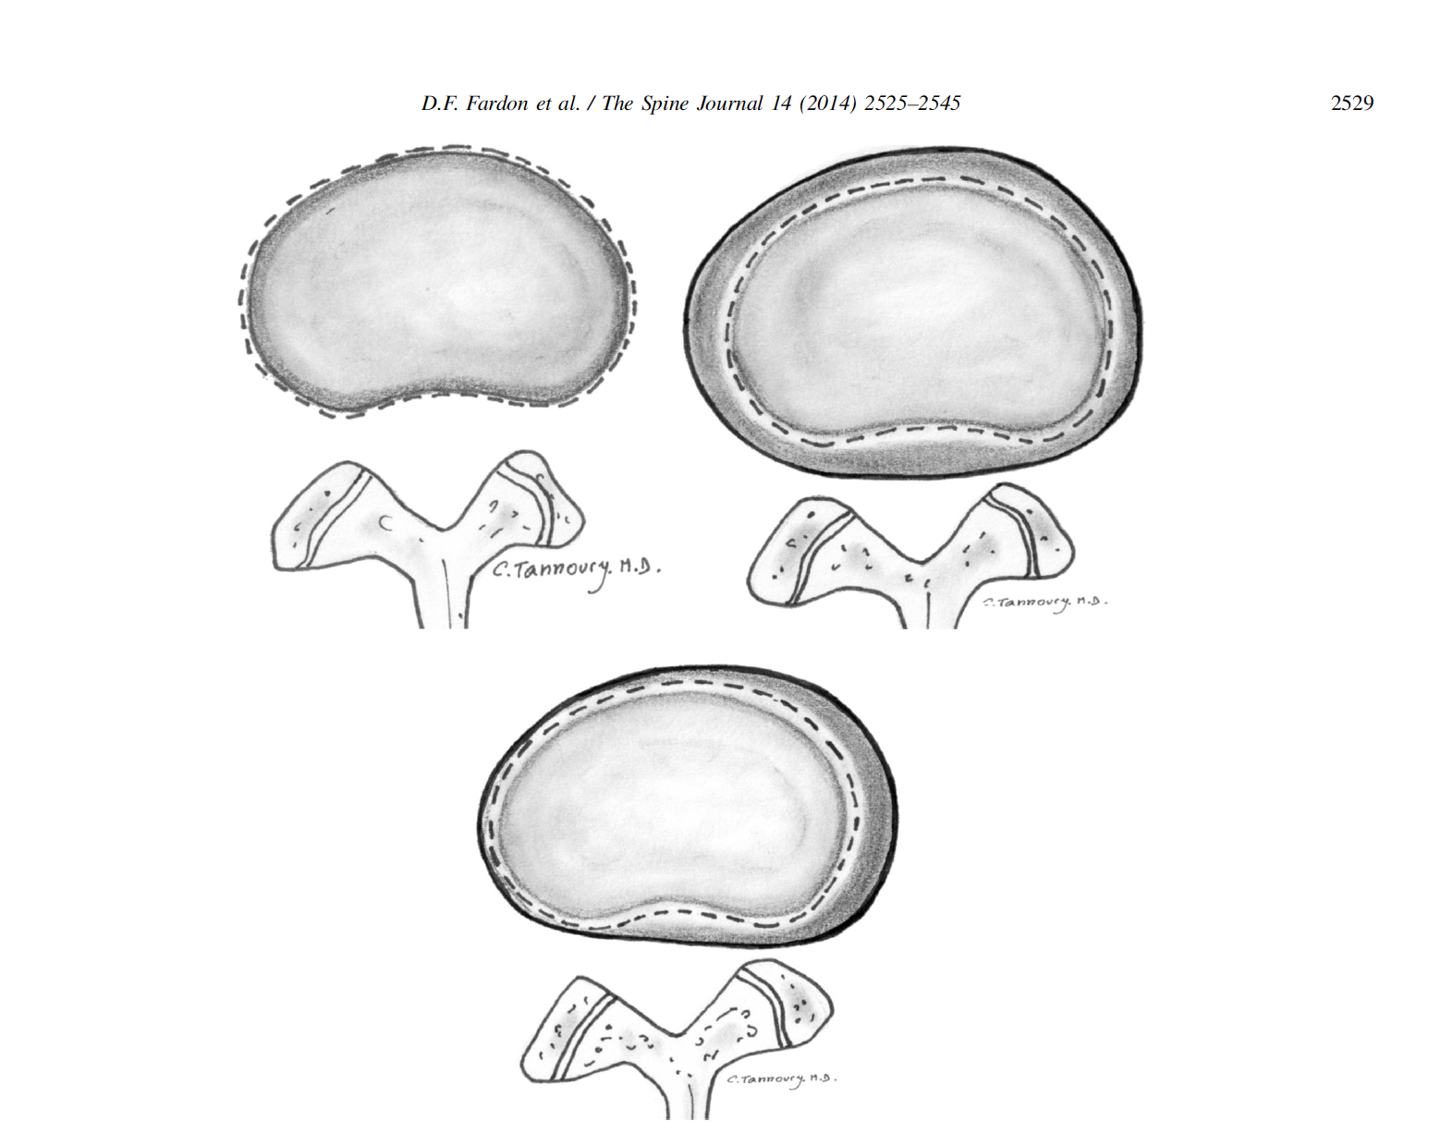
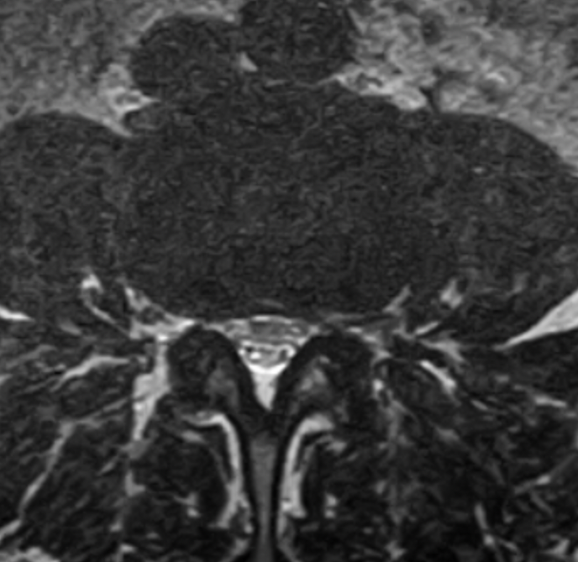


Notes:
In a normal disc, no disc material extends beyond the periphery of the disc space – in the following slide it is depicted by the broken line in the top left corner.
In a disc bulge (symmetrical) – the annular tissue extends beyond the edges of the vertebral apophysis symmetrically throughout the circumference of the disc.
In a disc bulge (asymmetrical) - the annular tissue extends beyond the edges of the apophysis asymmetrically greater than 25% of the circumference of the disc.
Therefore - a disc bulge will extend BEYOND the apophysis 25% - 100% of the disc circumference. That will be in CONTRAST to a disc herniation.
NOTES

Slide 61


Notes:
In a normal disc, no disc material extends beyond the periphery of the disc space – in the following slide it is depicted by the broken line in the top left corner.
In a disc bulge (symmetrical) – the annular tissue extends beyond the edges of the vertebral apophysis symmetrically throughout the circumference of the disc.
In a disc bulge (asymmetrical) - the annular tissue extends beyond the edges of the apophysis asymmetrically greater than 25% of the circumference of the disc.
Therefore - a disc bulge will extend BEYOND the apophysis 25% - 100% of the disc circumference. That will be in CONTRAST to a disc herniation.
NOTES

Slide 62
1
2
3
4

Slide 64
Notes:
In a herniated disc, disc material will be displaced beyond the apophysis LESS THAN 25%. This is a major way to differentiate a disc that was injured traumatically and one that is degenerative.
NOTES

Slide 65
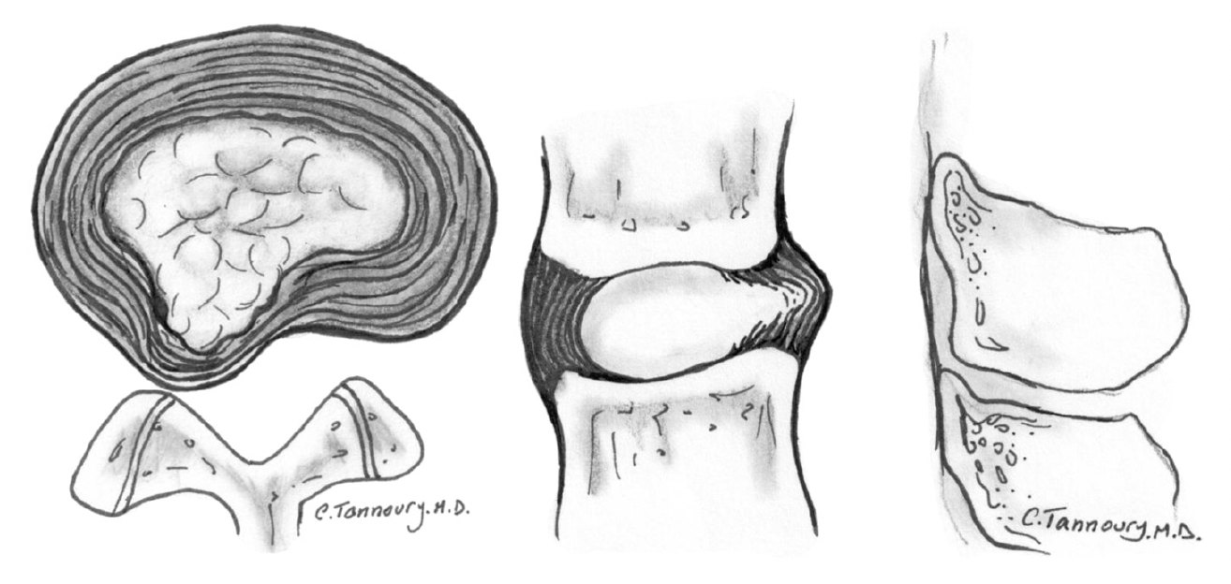
Notes:
This picture depicts what a disc herniation looks like. You can see the torn anulus fibrosis in the middle diagram, on the left is a very specific channel of nucleus proposes material heading out of the disk space area. That is definitely less than 25%.
NOTES

Slide 66
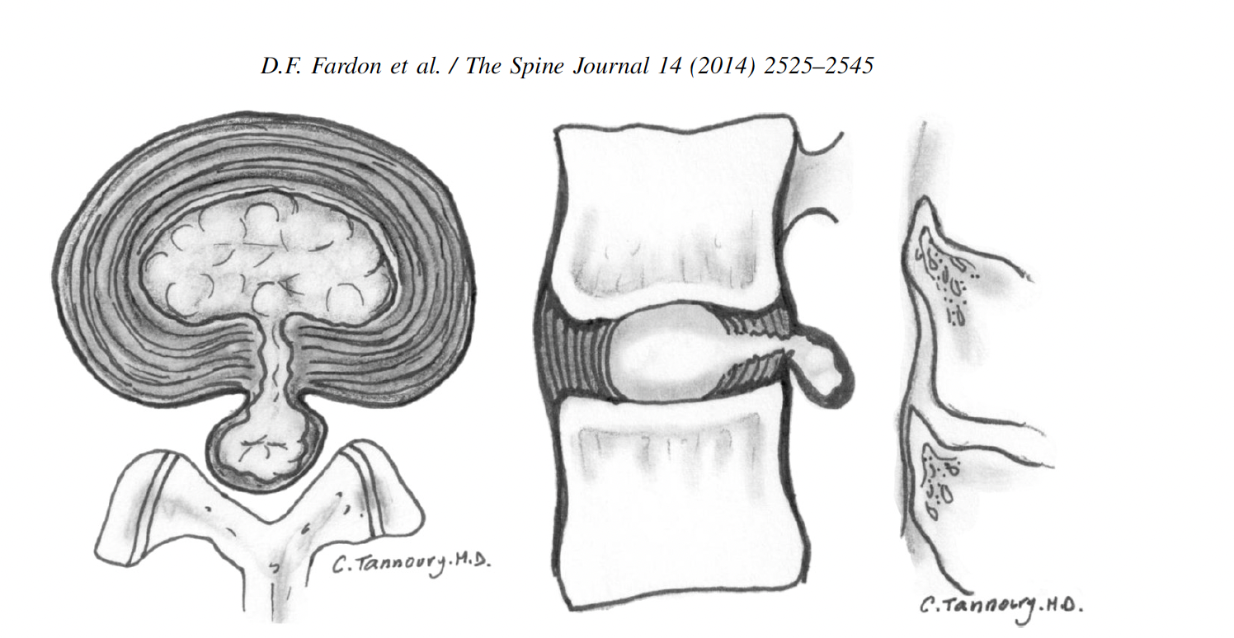
Notes:
Herniated disc can also be catalogued as an extrusion. And extruded disc demonstrates that the greatest measure of the displaced disc material is greater than the base of the displays material at the disk space of origin when measured in the same plane. What that means is that the base is narrower than the apex. The concern here is that if the base gets too narrow that the disc material can break off and float around the spinal canal. This is a dangerous situation because it can live anywhere from the neck to the lower back.
NOTES

Slide 67
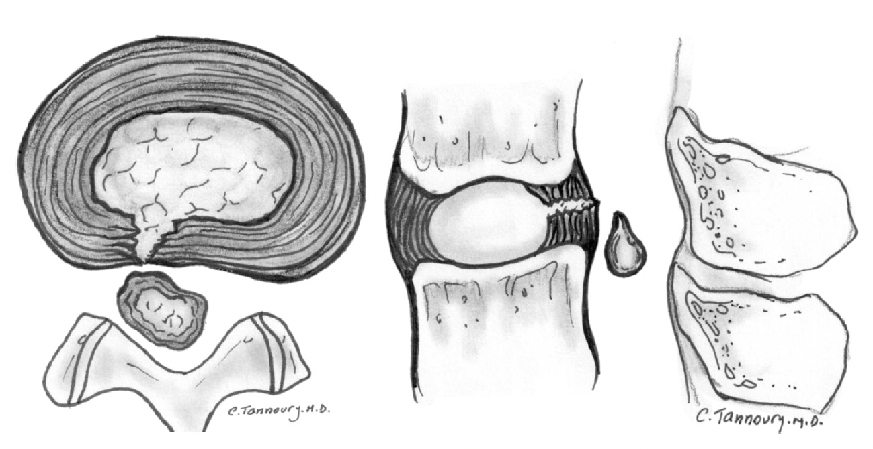
Notes:
This diagram depicts what a sequestered fragment looks like. This is where this can extrusion breaks off from the desk and as you can see that teardrop piece of this material can float around anywhere. That is diagnosed when the sagittal images show that a sequestered disc is an extruded disc in which the displaced disc material has lost all connection with the disc of origin.
NOTES

Slide 68

Alteration of Motion Segment Integrity
AMA Guides 5th & 6th Edition
Angular motion thresholds
Translational measurements
Clinical correlation required
Best when confirmed by STIR view on MRI
  Increased signal in spinal ligament
Florida Chiropractic Association – 2026

Slide 69
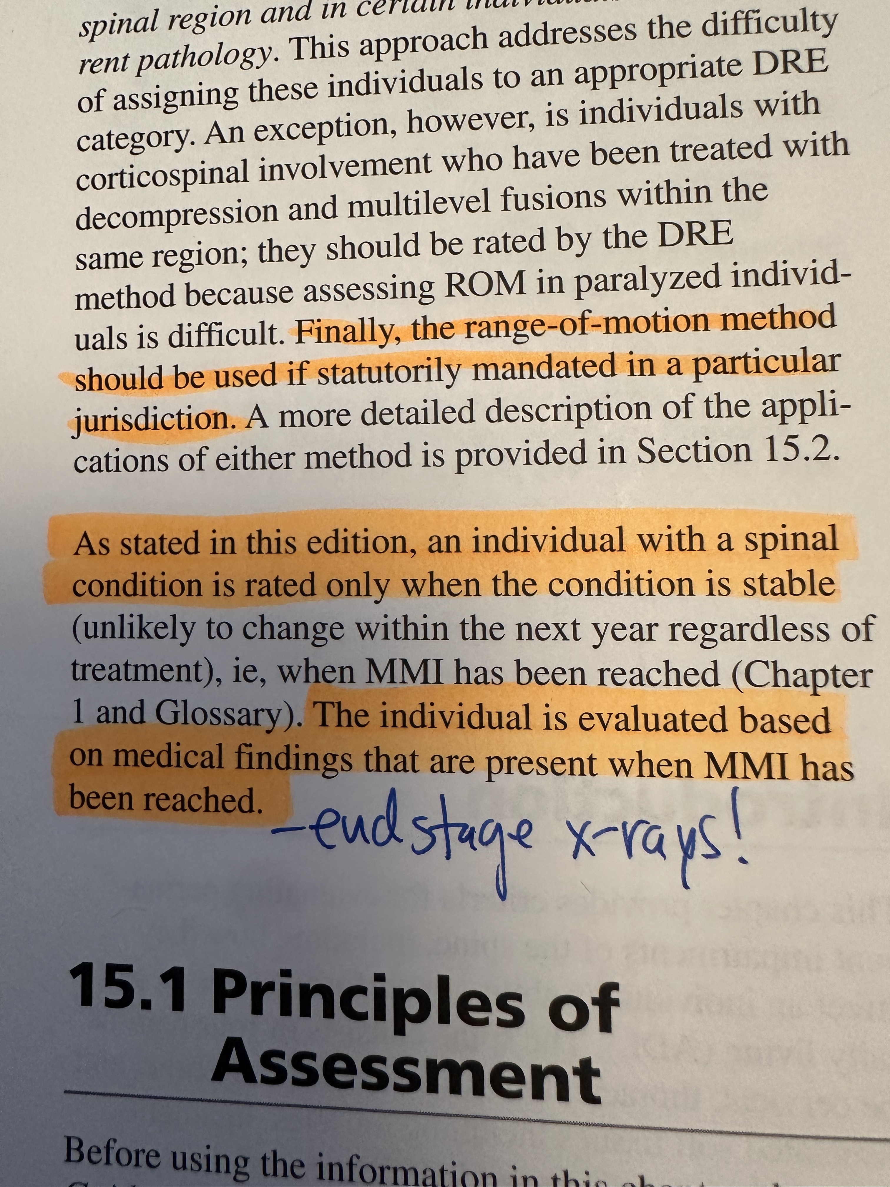
Alteration of Motion Segment Integrity
Florida Chiropractic Association – 2026

Slide 70

Defensible Documentation Language
Objective measurement vs opinion
  Inter-rater reliability
  Over-read and verification of MRI
Avoid overstating imaging findings
  Or relying on “over read” reports
Maintain interpretation chain – consensus is KEY
Clinical correlation required
Florida Chiropractic Association – 2026

Slide 71
Personal Injury Narrative Reporting
Clinical findings
  Issue is in the tissue
  Demonstrable
Imaging findings
  Dynamic radiographs
  MRI
Diagnosis and prognosis
  Tissue based
  S codes
Causal Relationship
  Be SPECIFIC
Mechanism of injury
  Bodily motion
Pre‑injury status
  Operating in a normal state of health
Florida Chiropractic Association – 2026

Slide 72

Causation Documentation
Reasonable degree of medical probability
  BE CERTAIN and STICK WITH IT
Aggravation vs exacerbation
  New injury or aggravation?
Acute vs chronic differentiation
  Timely evaluation and imaging is critical
Florida Chiropractic Association – 2026

Slide 73
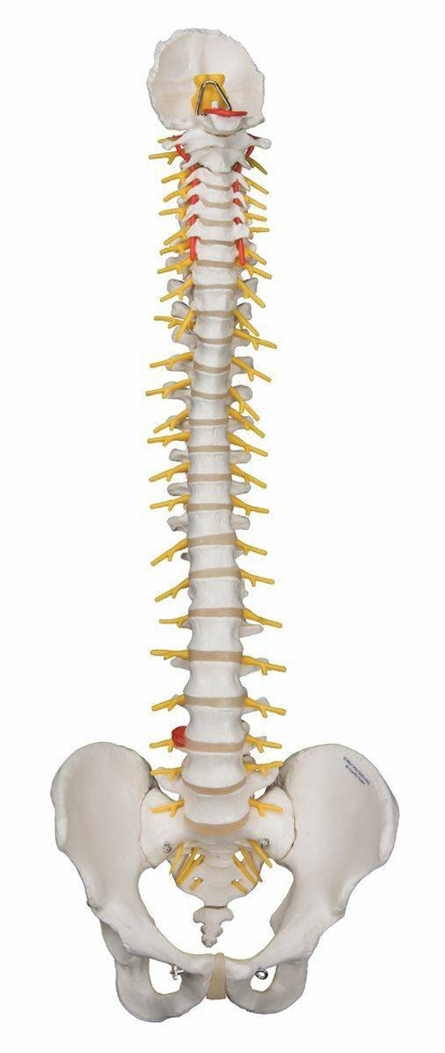
Documentation for Litigation
Consistency across records and providers
Avoid template contradictions
  EMR templates are there to GUIDE you
  Use MACROS and Scribing to help
Independent medical review considerations
  AI for review, critique and rebuttals
Florida Chiropractic Association – 2026

Slide 74
Key Takeaways
Documentation must support medical necessity
  Tests
  Referrals
  Treatments
E/M must reflect MDM complexity
  Complexity is KEY
Diagnosis must match examination findings
  Tissue injury
AOMSI requires measurable documentation
  Reproducible
  Independent
Florida Chiropractic Association – 2026

Slide 75


Questions & Discussion
William J Owens Jr DC FSBT
c – 716-228-3847
e – wowens@nationalspinemanagement.com
Florida Chiropractic Association – 2026

