Slide 1

Why patients decline care:
Improving communication and adherence in chiropractic practice
JUSTIN RABINOWITZ, DC

Slide 2

THIS IS FOR YOU IF...
Take insurance, declining reimbursements

Slide 3
THIS IS FOR YOU IF...
Take insurance, declining reimbursements
Cash based… but undercharging

Slide 4
THIS IS FOR YOU IF...
Take insurance, declining reimbursements
Cash based… but undercharging
Unsure where to start, don't want old model

Slide 5
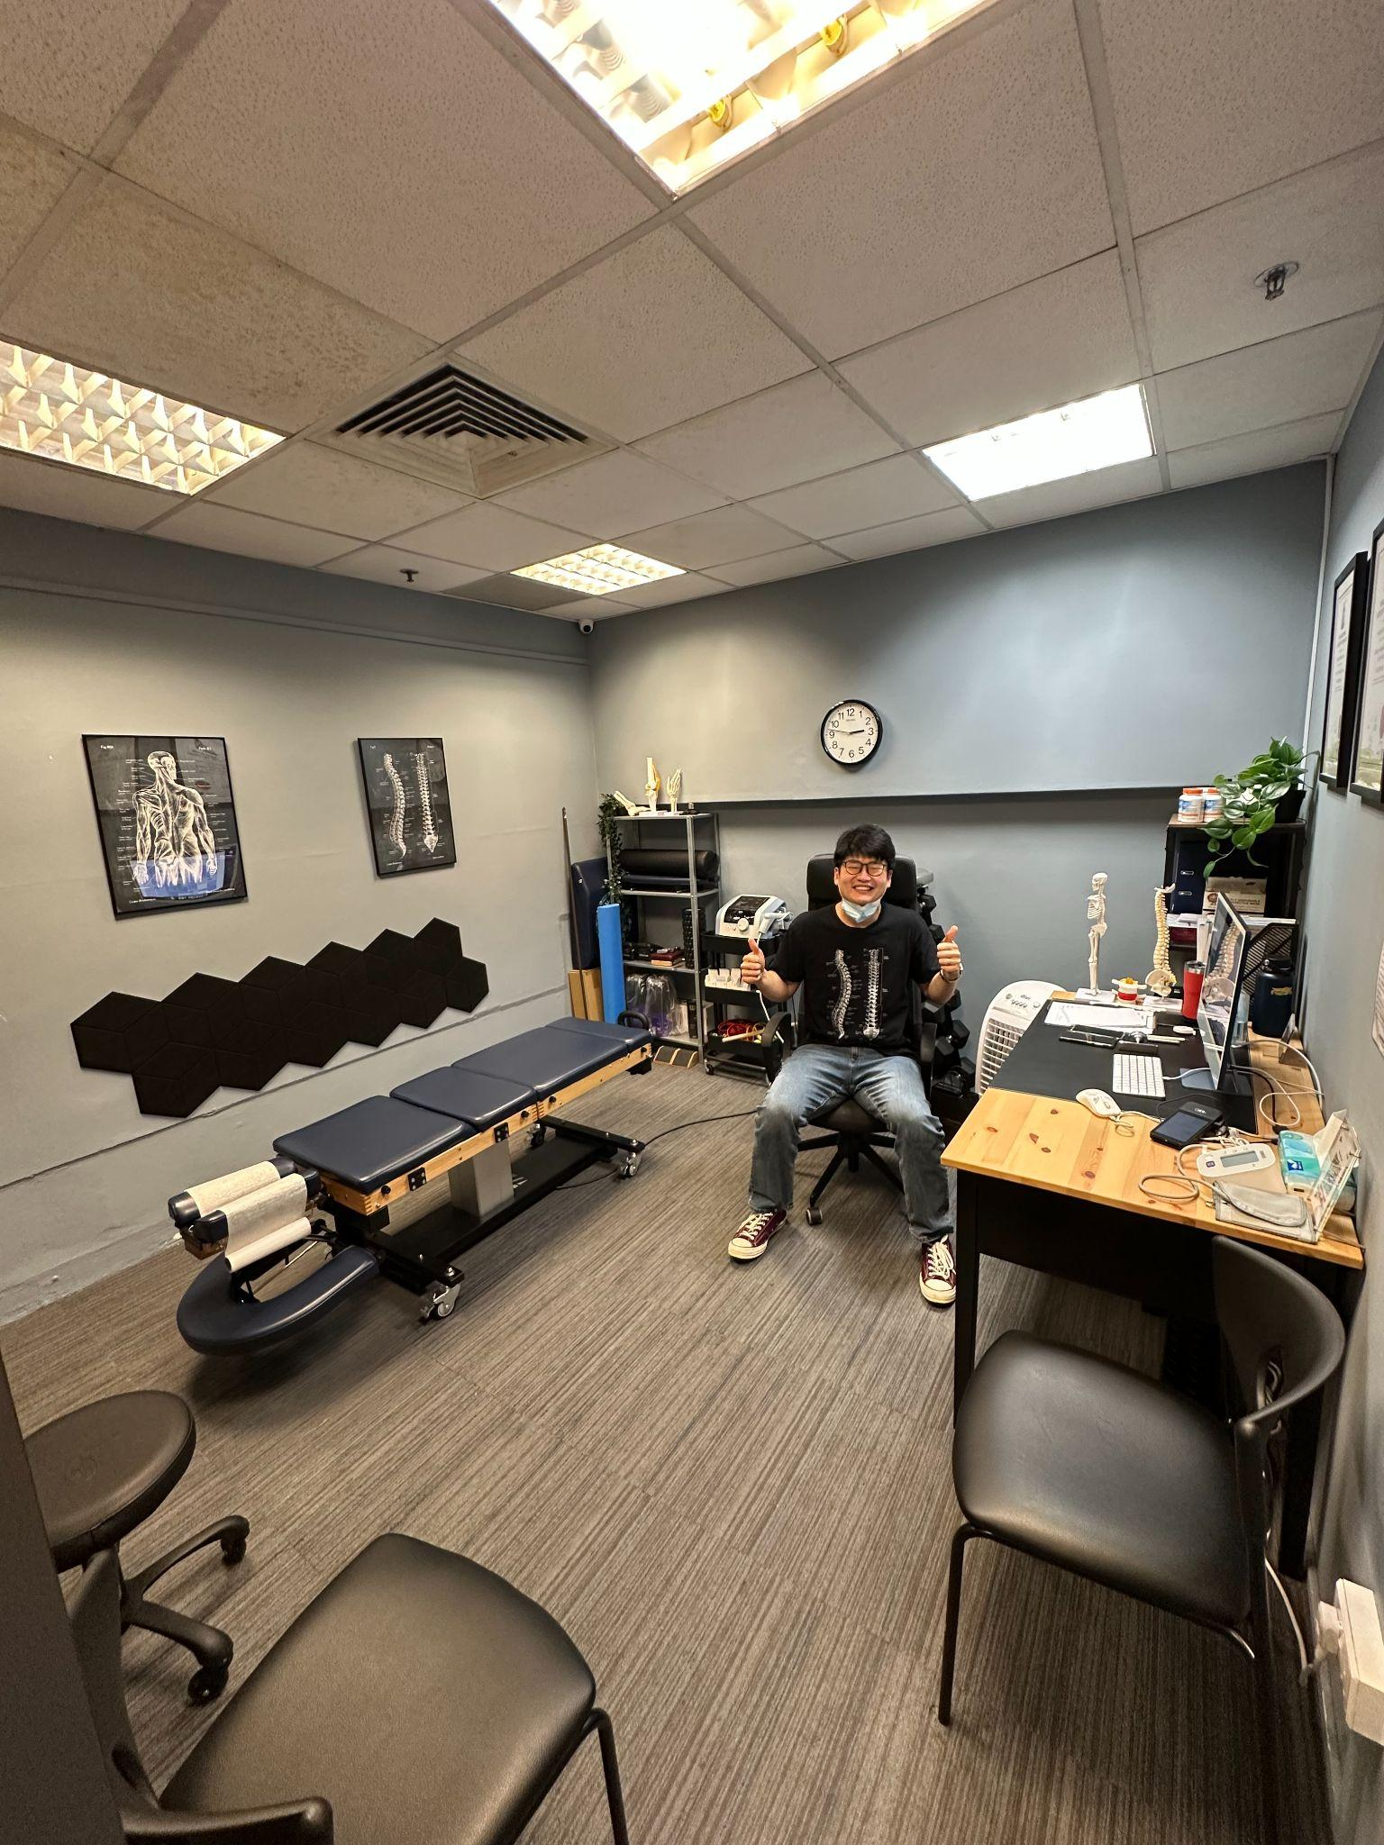

MY STORY

Slide 6
WHICH IS GREAT FOR ME…

Slide 7
WHICH IS GREAT FOR ME…
BUT WHAT ABOUT YOU?

Slide 8
I COULD TEACH YOU...
HOW TO DROP
INSURANCE

Slide 9
I COULD TEACH YOU...
HOW TO MAKE MORE AND
WORK LESS

Slide 10
I COULD TEACH YOU...
HOW TO CHARGE WHAT
YOU ARE WORTH

Slide 11
I COULD TEACH YOU...
HOW TO HIRE AND
RETAIN STAFF

Slide 12
I COULD TEACH YOU...
HOW TO BUILD A
MARKETING FUNNEL

Slide 13
I COULD TEACH YOU...
HOW TO BUILD YOUR PRACTICE
SO IT RUNS WITHOUT YOU

Slide 14
I COULD TEACH YOU...
HOW TO INVEST IN
REAL ESTATE AND PROPERTY

Slide 15
BUT I'M NOT GOING TO…

Slide 16
BECAUSE THAT ALL COMES
AFTER ONE THING

Slide 17
WHY THEY SAY NO!

Slide 18


Slide 19

Value For Unique Solution

Slide 20
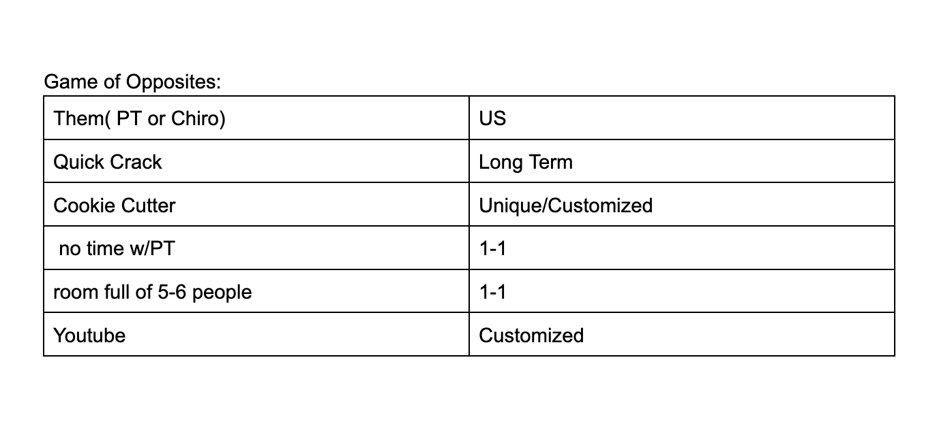

Slide 21
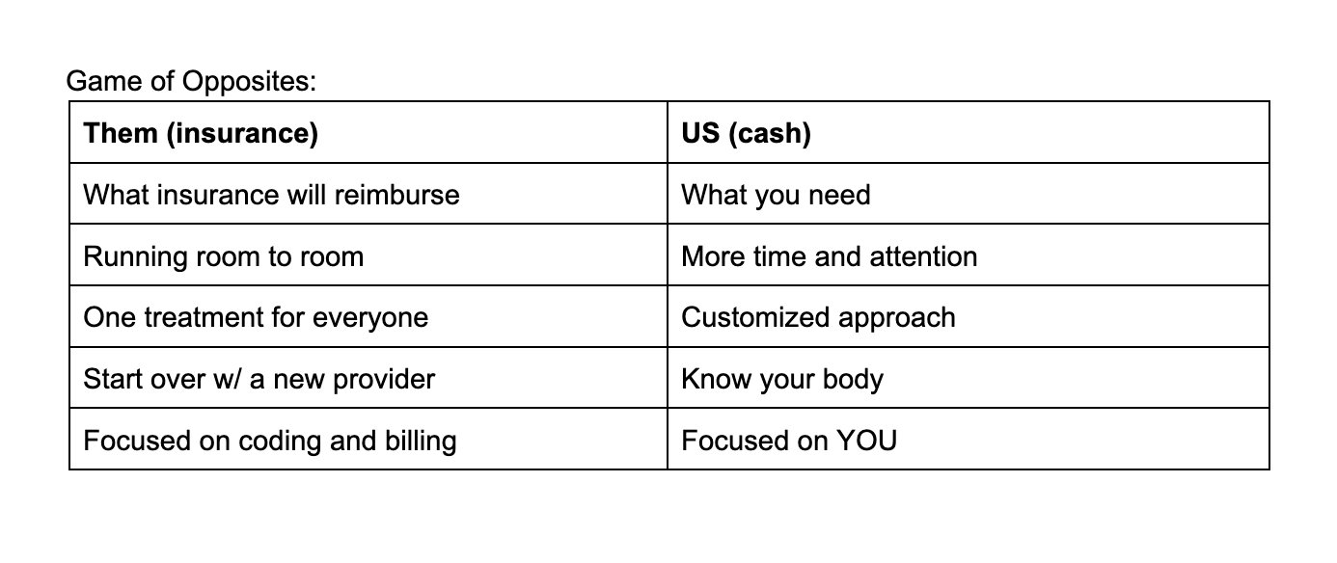

Slide 22
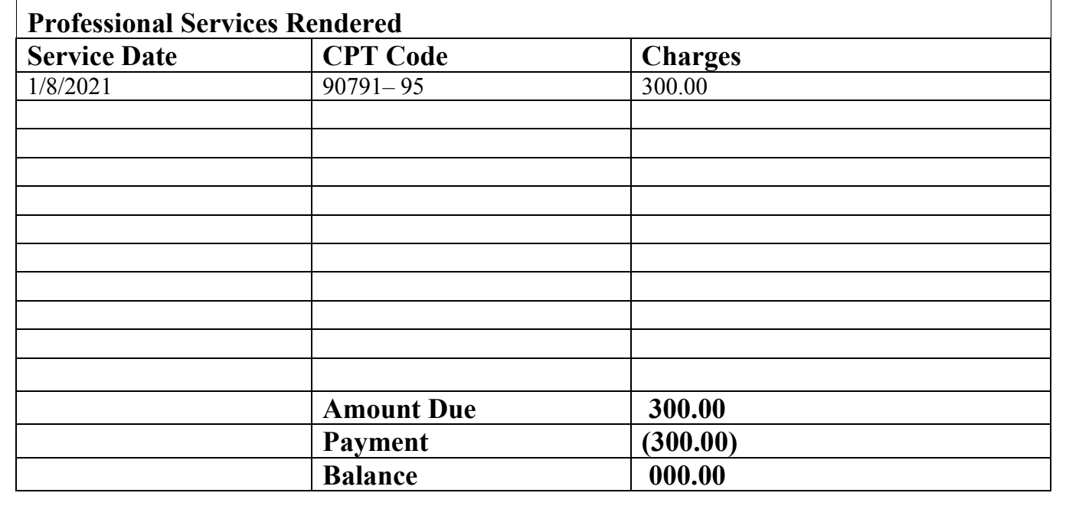
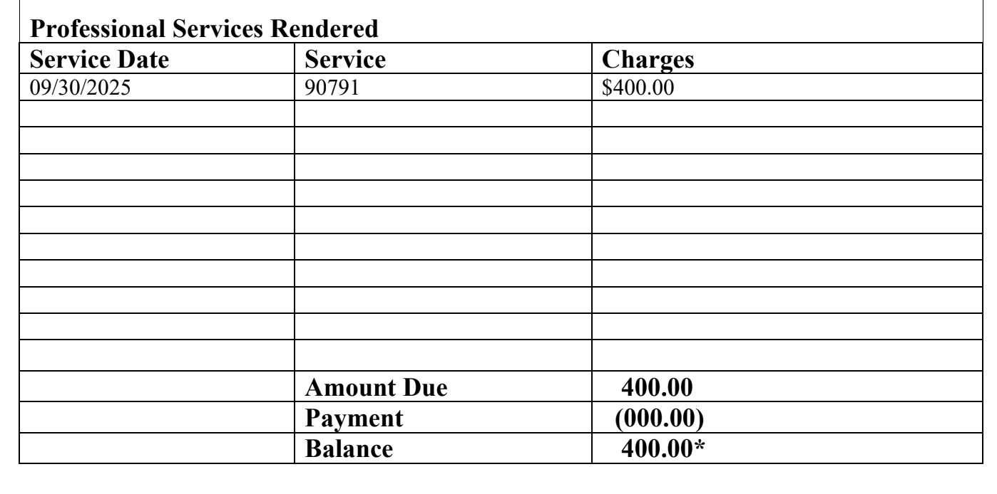

Slide 23


desire

Slide 24
HAVE YOU TRIED ANYTHING?
WHY NOW?

Slide 25
BEFORE I'M DONE…
IS IT THE PROFESSION?
OR IS IT US?

Slide 26
THANK YOU!
@JUSTINRABINOWITZ

