Slide 1
Evaluating, Treating, Rehabilitating, and Optimizing Breath and Diaphragm Function
The FCA National Convention and Expo – August 2026
Stephen C. Gangemi, DC, DIBAK, DCBCN, DACBN
© Dr. Stephen Gangemi – Systems Health Care

Slide 2
Diaphragm Anatomy & Physiology
O: Xiphoid, ribs 7-12 with/ transverse abs, upper lumbar vertebrae/arcuate ligaments
T10 hiatus: Esophagus and vagus nerve
T12 hiatus: Aorta, thoracic duct, and azygos vein
I: All converge into the central tendon, fibrous pericardium, & fascial connections into the tongue
T8 hiatus: Inferior vena cava & right phrenic nerve
© Dr. Stephen Gangemi – Systems Health Care

Slide 3
Diaphragmatic Breathing
Improves parasympathetic tone
Improves pH
Increases the brain’s alpha waves
Raises O₂ levels
Regulates intra-abdominal pressure in ways that impact digestion, posture, movement & pelvic floor function, and fluid dynamics
Helps overcome stressful situations
© Dr. Stephen Gangemi – Systems Health Care

Slide 4
Nasal Breathing
Activates the diaphragm
Raises nitric oxide (NO) production
Improves sense of smell
Decreases CO₂ sensitivity
Increases baroreflex sensitivity
Improves sinus function
© Dr. Stephen Gangemi – Systems Health Care

Slide 5
Slows, warms, and humidifies the air
Improves dental and gum health
Raises oxygen uptake in blood (5-15% increase in body oxygenation)
Removes a significant amount of infectious substances
Slows breathing rate (PARASYM response) and offers natural nasal resistance to reduce hyperventilation & hyperinflation
Modulates emotional regions of the brain
Nasal Breathing
© Dr. Stephen Gangemi – Systems Health Care

Slide 6

Is Your Patient Lying on Your Table With Their Mouth Open?
© Dr. Stephen Gangemi – Systems Health Care

Slide 7
Signs and Symptoms of Poor Breathing
Easily stressed
Shallow breaths (anxiety) or big audible breaths at rest
Tight neck, jaw, and facial muscles; shoulder girdle & TMJ/dental issues
Poor “core” stability; low back and pelvic problems
Fatigue, lack of endurance (both physical & mental)
Asthma & other breathing problems/respiratory diseases
Sleep difficulty
Sexual dysfunction
Yawning, sighing, snoring, mouth breathing
© Dr. Stephen Gangemi – Systems Health Care

Slide 8
Signs and Symptoms of Poor Breathing
Phrenic nerve issues (sensory and motor control)
  Sensory: shoulder/neck pain, breathing pain, hiccups
  Motor: breathlessness (often silent), sleep apnea, fatigue
Brachial and cervical plexus problems (e.g., TOS)
© Dr. Stephen Gangemi – Systems Health Care

Slide 9
Breathe Before You Crawl
Breathing
Head control
Rolling
Rocking
Gait – cross crawl
© Dr. Stephen Gangemi – Systems Health Care

Slide 10
How Long Can You Hold Your Breath?
Or better yet – how long can you control your breath?
  At rest (2 minutes?)
  During exertion
  If you had to survive
© Dr. Stephen Gangemi – Systems Health Care

Slide 11
How Long Can You Hold Your Breath?
Breath hold is influenced by many factors.
  Breathing patterns (mechanics)
  Stress (anxiety = less breath hold time)
Breath hold time is a useful measurement, but not a reflection of O₂ levels or CO₂ adaptation.
© Dr. Stephen Gangemi – Systems Health Care

Slide 12
Measure Your Body Oxygen Level Test (BOLT)
Also Known As: CONTROL PAUSE
This test measures your relative breathing volume, called a control pause.
Take a small silent nasal breath. After the exhale pinch your nose and time how long until your first involuntary movement to breathe.
Following the pause, your first breath should be the same as prior to the measurement.
A longer breath hold time indicates better health.
The BOLT score measures progress, improving by 3-4 sec/week with daily breathing exercises. You will feel better with each 5-second increase.
© Dr. Stephen Gangemi – Systems Health Care

Slide 13
Reflexive Breathing
Reflexive breathing is how you breathe when you’re not thinking about it.
It is closely correlated with the status of the nervous system.
© Dr. Stephen Gangemi – Systems Health Care

Slide 14
Phases of Breathing
Inhale
Retention (holding air)
Exhale
Suspension (pause after normal exhale)
  A healthy breath pauses at suspension. An unhealthy breath pauses at retention.
Taking a “big, deep breath” causes the blood vessels to narrow which in turn reduces O₂ delivery to the cells.
© Dr. Stephen Gangemi – Systems Health Care

Slide 15

The key is to pay attention to whether you are tensing your body or restricting your breathing by force and control.
If so, first focus on bringing a feeling of relaxation to your body, then gently and gradually allow your breathing to become quieter and calmer until you feel tolerable air hunger.
Interoceptive Anxiety:
Most people slow their breathing when they pay attention to it.
However, some people find it uncomfortable to observe their breathing or other sensations and the attention causes breathing rates to increase and become erratic. If you find this happening, concentrate on practicing Many Small Breath Holds, listening to music, or using meditation and visual aids for relaxation.
© Dr. Stephen Gangemi – Systems Health Care

Slide 16
CO₂ – Way More Important Than You Think
Decrease your CO₂ sensitivity! (Improve your tolerance)
Not just a waste gas
NH3 detoxification via the urea cycle
Decreases anxiety by increasing GABA levels (CO₂ generated from CAC)
Decreases blood pH and dilates blood vessels
Oxygen bound to hemoglobin is released in the presence of CO₂
  Pulse oximeter 97-99% (not 100%!)
Masks – nasal breathing and CO₂ tolerance
© Dr. Stephen Gangemi – Systems Health Care

Slide 17
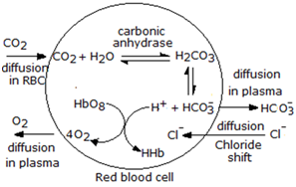

CO₂ & The Bohr Effect
The Bohr Effect is the chemical relationship between CO₂ and O₂. Increased CO₂ leads to an increased release of O₂ by hemoglobin.
Excessive breathing results in exhaling too much CO₂.
When we offload too much CO₂ and decrease this concentration of CO₂ then we decrease the delivery of O₂ to our cells.
This then results in over-breathing, increasing the rate of breath to get more air in.
…and that results in exhaling excessive amounts of CO₂.
So, breathe less to release more O₂.
© Dr. Stephen Gangemi – Systems Health Care

Slide 18
Nitric Oxide (NO)
Mediates a variety of biological functions such as vascular relaxation, platelet aggregation, neurotransmission, and immune regulation
Produced by almost every cell type in the body
Produced in high amounts from macrophages
Modulates T-cell mediated immune response
© Dr. Stephen Gangemi – Systems Health Care

Slide 19
Nitric Oxide
Your nose harnesses nasal nitric oxide (NO) released in the nasal airway during respiration. It’s your natural Viagra.
During a nasal inhale, NO follows the airstream to the lower airways and lungs. This is important because it increases arterial oxygen tension and reduces pulmonary vascular resistance.
The slower your flow rate of breathing, the higher the NO concentration.
Your nose performs more than 30 functions related to breathing. Your mouth provides ZERO.
Animals only breathe through their mouth when sick or stressed.
SLOW down your breathing. A slow mouth breath is NOT the same as a slow nasal breath.
© Dr. Stephen Gangemi – Systems Health Care

Slide 20
Regulatory T-Cells & Nitric Oxide
“NO-Tregs may suppress Th17 via the production of IL-2, which has been shown to be a key inhibitor of Th17 differentiation.”
“Our results therefore demonstrate the differential suppressive function between NO-Tregs and nTregs and indicate specialization of the regulatory mechanism of the immune system.”
  Niedbala W, et al. Nitric oxide-induced regulatory T cells inhibit Th17 but not Th1 cell differentiation and function. J Immunol. 2013.
© Dr. Stephen Gangemi – Systems Health Care

Slide 21
Regulatory T-Cells & Nitric Oxide
“Immunologically, nitric oxide may have evolved to fine tune the immune homoeostasis in health and disease.”
“Nitric oxide markedly increased the proliferation, division and viability of CD4+CD25− T cells to CD4+CD25+ T cells.”
  Niedbala W, et al. Nitric oxide induces CD4+CD25+ Foxp3 regulatory T cells from CD4+CD25 T cells via p53, IL-2, and OX40. Proc Natl Acad Sci. 2007.
© Dr. Stephen Gangemi – Systems Health Care

Slide 22
Breathe Better for Your Heart
A research study of a Minneapolis Intensive Coronary Unit found that out of 153 heart attack victims, 100% breathed predominantly using their upper chest, 75% were chronic mouth-breathers, and 70% were open-mouth breathers during sleep. The Breathing Cure by Patrick McKeown
© Dr. Stephen Gangemi – Systems Health Care

Slide 23
Breathe Better for Your Heart
Slow breathing at 6 breaths/min increases baroreflex sensitivity and reduces sympathetic activity and chemoreflex activation, suggesting a potentially beneficial effect in hypertension.
  Hypertension. 2005; 46:714–718
© Dr. Stephen Gangemi – Systems Health Care

Slide 24
Baroreflex Sensitivity
This is the heart’s ability to adjust blood pressure in changing conditions.
Early indicator of cardiovascular health and autonomic dysfunction
Two minutes of slow breathing can raise this sensitivity
Activates the parasympathetic nervous system
Helps restore autonomic balance
Increases arterial function & improves tissue oxygenation
© Dr. Stephen Gangemi – Systems Health Care

Slide 25
If There is a “Core” It’s Your Diaphragm
A strong diaphragm = A strong core
2016 Osteopathic Centre for Research Studies in Ancona, Italy found that people who suffer from lower back pain and SI joint dysfunction often have fatigue of their diaphragm. They cite “poor diaphragm endurance” caused by an overexertion of the respiratory muscles. Basically, they’re breathing too hard in an inefficient manner. The Breathing Cure by Patrick McKeown
© Dr. Stephen Gangemi – Systems Health Care

Slide 26
Some Often Confused Diaphragm A & P
5th intercostal space (A lot higher than you think.)
Arcuate ligament: transverse process of L1 to lower 12th rib forming an arch over the QL to join the diaphragm fascia
Transverse abdominals and psoas connection
It moves how much? (A lot less than what you think.)
A strong diaphragm provides the mechanical circulation for the lymphatic system.
© Dr. Stephen Gangemi – Systems Health Care

Slide 27



Cranial and Pelvic Respiratory Sequence: Inspiration
The diaphragm descends along with the pelvic diaphragm.
The cranium expands by flaring outwards (the temporal bones), as does the pelvis (the ilia).
The sacral base moves posteriorly, the sacral apex anteriorly, and the coccyx apex posteriorly. As this occurs, the occipital base moves anteriorly and superiorly.
Each ilium rotates anteriorly along with the temporal bone squamous area, so the mastoid process moves posteriorly along with the ischial tuberosity.
© Dr. Stephen Gangemi – Systems Health Care

Slide 28
Cranial and Pelvic Respiratory Sequence: Expiration
The diaphragm ascends along with the pelvic diaphragm.
The cranium narrows inwardly (the temporal bones), as does the pelvis (the ilia).
The sacral base moves anteriorly, the sacral apex posteriorly, and the coccyx apex anteriorly. As this occurs, the occipital base moves posteriorly and inferiorly.
Each ilium rotates posteriorly along with the temporal bone squamous area, so the mastoid process moves anteriorly along with the ischial tuberosity.
© Dr. Stephen Gangemi – Systems Health Care

Slide 29
The Pelvic Floor
The pelvic floor (pelvic diaphragm) should mirror the breathing diaphragm. As the diaphragm ascends and descends, so should the pelvic floor.
© Dr. Stephen Gangemi – Systems Health Care

Slide 30
Pelvic Floor Integration
Before inhalation, electrical activity can be observed in the muscles of the pelvic floor, as well as the transverse and internal oblique abdominal muscles.
© Dr. Stephen Gangemi – Systems Health Care

Slide 31
Respiratory Diaphragm – Pelvic Diaphragm Integration Exercise!
Test ROM
Forward flexion, breathe in, press your hands down towards the pelvic floor
Extend back up, breathe out, scoop your hands back upwards
Five to six repetitions
Retest ROM
© Dr. Stephen Gangemi – Systems Health Care

Slide 32
The Psoas
Origin: TP of L1-L5, bodies of T12-L5, discs of T12-L4
Insertion: Medial surface of the lesser trochanter of the femur
Action: Flexes and medially rotates the hip
© Dr. Stephen Gangemi – Systems Health Care

Slide 33
The Psoas Involvement
Clinical Significance:
Pain flexing forward
Prolonged sitting problems
Diaphragm significance (Crura “legs”)
Hemorrhoids
Hamstring tightness
Kidney relationship
© Dr. Stephen Gangemi – Systems Health Care

Slide 34
The Psoas Insertion and Low Back Pain
Medial surface of the lesser trochanter of the femur
Extremely sensitive trigger point often resulting in dramatic pain relief!
Supine, standing, or forward flexion low back pain
© Dr. Stephen Gangemi – Systems Health Care

Slide 35
The Quadratus Lumborum
Origin: Inferior border of the 12th rib
Insertion: TP of L1-L4, iliolumbar ligament, posterior 1/3 of iliac crest
Action: Laterally flexes the trunk, fixes 12th rib during respiration
© Dr. Stephen Gangemi – Systems Health Care

Slide 36
The QL Involvement With Breathing and Low Back Pain
Clinical Significance:
“Short leg” syndrome
Cough/sneeze pain
“Disc-type” pain
© Dr. Stephen Gangemi – Systems Health Care

Slide 37
Testing for a Diaphragm Problem
Correcting diaphragmatic injuries, imbalances, and breathing problems will lead not only to improved breath and core strength (due to its integration with the transverse abdominal muscles and psoas muscles), but also to an improved autonomic nervous system due to its impact on the parasympathetic system.
© Dr. Stephen Gangemi – Systems Health Care

Slide 38
Testing for a Diaphragm Problem
Perform breath cessation: Ask the patient to stop breathing (not a quick breath in or out and then hold the breath).
If the diaphragm is not functioning properly, then a weak muscle will strengthen.
© Dr. Stephen Gangemi – Systems Health Care

Slide 39
Testing for a Diaphragm Problem
Test the psoas muscles.
One, or sometimes both, psoas muscles will become weak when the breath is stopped if there is a problem with the diaphragm.
© Dr. Stephen Gangemi – Systems Health Care

Slide 40
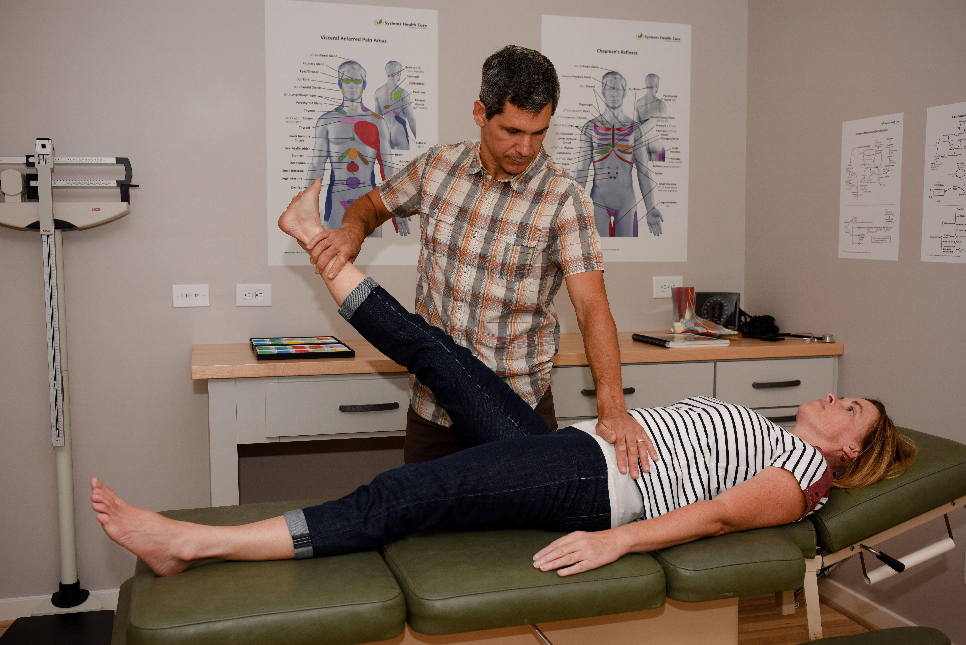
Testing for a Diaphragm Problem
© Dr. Stephen Gangemi – Systems Health Care

Slide 41
Testing for a Diaphragm Problem
Myofascial restrictions
  Anterior are found along the transverse abdominal or psoas muscles.
  Posterior on the arcuate ligament
© Dr. Stephen Gangemi – Systems Health Care

Slide 42
Testing for a Diaphragm Problem
Check the patient’s diaphragm Chapman’s Reflex (on the sternum).
© Dr. Stephen Gangemi – Systems Health Care

Slide 43
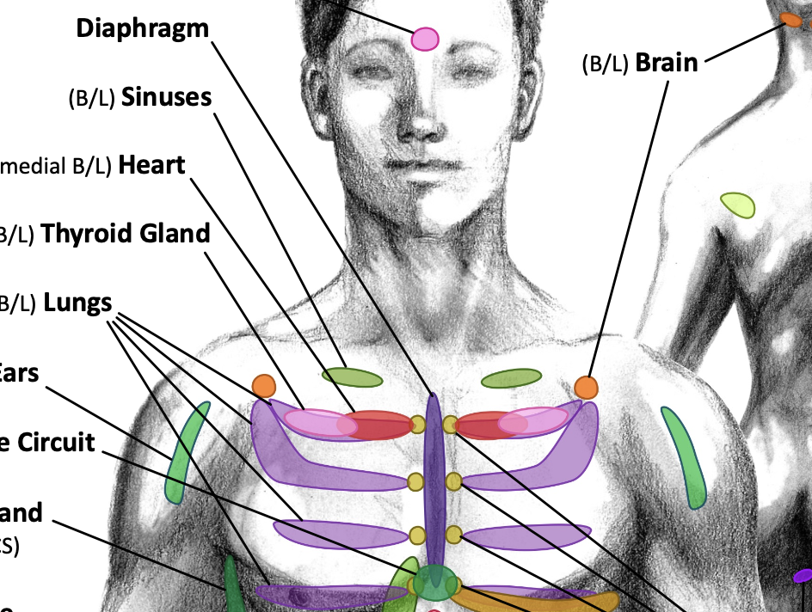
Diaphragm Chapman’s Reflex
©Stephen C. Gangemi, DC; Illustration of Locations by Weston Holzinger, DC; Artwork by Kenzie K. Holzinger
© Dr. Stephen Gangemi – Systems Health Care

Slide 44
Diaphragm Rehab
Tongue position!
Types (rates) of breathing
  Cadence (4:6 or 5:5) ideal for HRV
  Soft & quiet – hide your breath
    Minimal “air hunger”
Body positions
© Dr. Stephen Gangemi – Systems Health Care

Slide 45
Diaphragm: Breathing & Movement
As you breathe in the ribs move out and the diaphragm flattens downward which helps relax the pelvic floor.
As you exhale, the rib cage relaxes, the diaphragm moves back up to its dome shape, and the pelvic floor contracts.
The diaphragm provides stability to the spine and influences lymph flow. It is made up of striated muscle fibers, just like skeletal muscle, and therefore can be strengthened.
Watch out for dysfunction:
  Minimal movement of lower ribs or back
  Visible vertical movement in shoulders, chest, and neck
  Pushing the belly out versus letting the diaphragm drive the movement
  Audible breathing
  Mouth opening, even slightly, or tongue dropping off the roof of the mouth
  Paradoxical breathing: when the diaphragm moves in the opposite direction (mineral deficiency, respiratory distress, lung cancer or other degenerative disease, or physical trauma)
© Dr. Stephen Gangemi – Systems Health Care

Slide 46
Dysfunctional breathing impairs the diaphragm and impacts all three breathing dimensions.
A constricted diaphragm and disordered breathing can result in:
  Anxiety
  Back pain
  Increased breathlessness
  Reduced diaphragm thickness which can affect athletic performance
  Shoulder shrug (shoulders tend to rise and hold tension)
  Heartburn / acid reflux
  Frequent hiccups, excessive yawning, frequent sighing
  Pelvic floor symptoms
  Incontinence / pressure management / bladder control
  Sleep problems
  Daytime fatigue or feeling wired / hyperactive
  ADHD should be a strong indicator for a sleep study and airway evaluation.
  Chronic earaches, sore throats, illness
  Dental cavities
© Dr. Stephen Gangemi – Systems Health Care

Slide 47
Tongue Position
Where is your tongue right now? (It should be flat up against your palate.)
© Dr. Stephen Gangemi – Systems Health Care

Slide 48
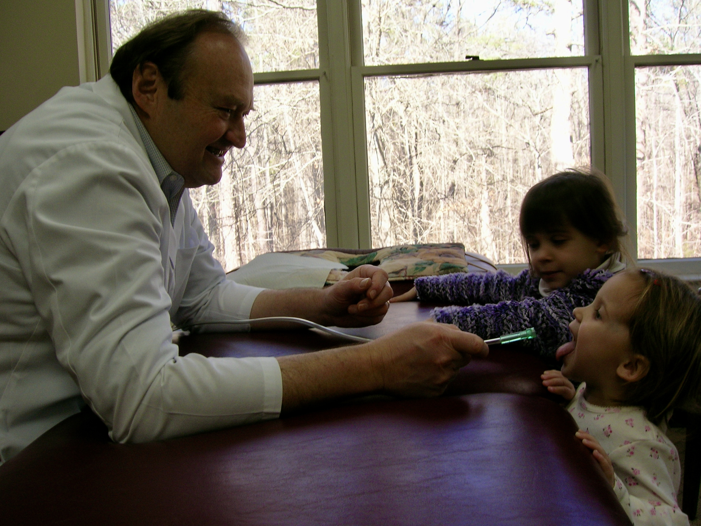

Slide 49

WHERE’S YOUR TONGUE?
The tongue has many vital tasks from breathing to eating and drinking and talking. Proper tongue posture influences body posture. It influences our central nervous system state, and the flow of lymph. The tongue influences the pressure in our chest, lungs, and abdomen to harmonize with the respiratory diaphragm and the pelvic floor. The resting posture and function of your tongue matters.
© Dr. Stephen Gangemi – Systems Health Care

Slide 50
The “N-SPOT” and Beyond...
When the entire tongue rests on the palate, the tip touches the N-spot (incisive papilla), and the middle and back of the tongue are up, then it balances pressure on the cheeks and assists in maintaining stability and function of the TMJ.
When the tongue rests on the palate in this way, breathing will be through the nose, the lips will be closed, and the oral cavity will be sealed. This practice helps keep the airway open, particularly during sleep.
This provides support for the head & neck, improves posture, gait, & balance, and activates the diaphragm. It also stimulates the parasympathetic system.
© Dr. Stephen Gangemi – Systems Health Care

Slide 51
Tongue Posture Check Point
Suction your tongue to the roof of your mouth and hold it there.
Open your mouth while maintaining the suction.
Now block your nose and attempt to breathe through your mouth.
If your tongue is properly suctioned up, then you cannot breathe through your mouth.
If your tongue is in a lower posture or only the tip is up, you don’t have a suction making it possible to mouth breathe.
© Dr. Stephen Gangemi – Systems Health Care

Slide 52

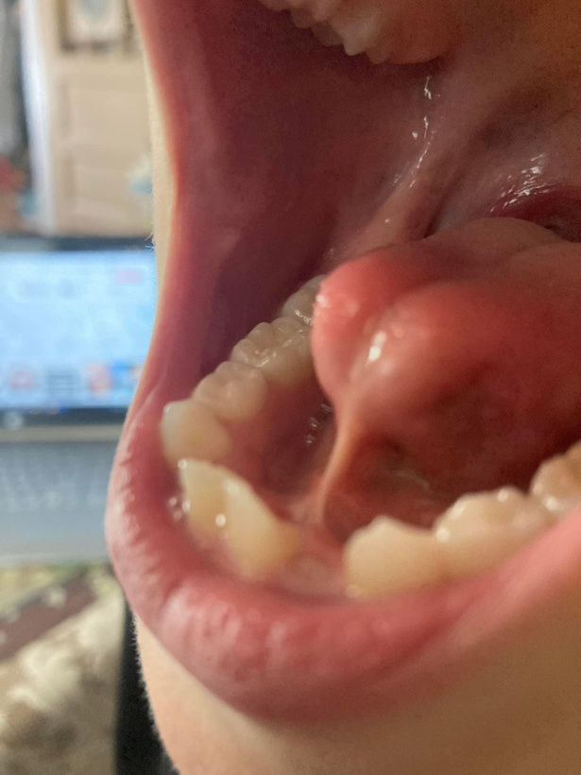
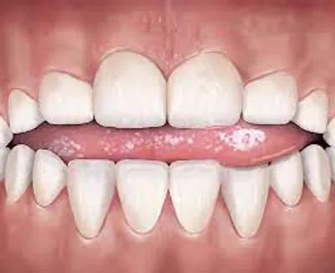
Functional breathing depends on the tongue's capacity to adhere to the roof of the mouth at rest, rise for swallowing, and move flexibly for eating and speaking.
Chronic congestion can lead to habitual mouth breathing. Look for a crease on the nose, “the nasal salute,” or listen to nasal patency.
Tongue thrust is when the tongue presses forward rather than upward when swallowing.
Tongue tie (ankyloglossia) is one of many causes for the tongue to be low.
© Dr. Stephen Gangemi – Systems Health Care

Slide 53
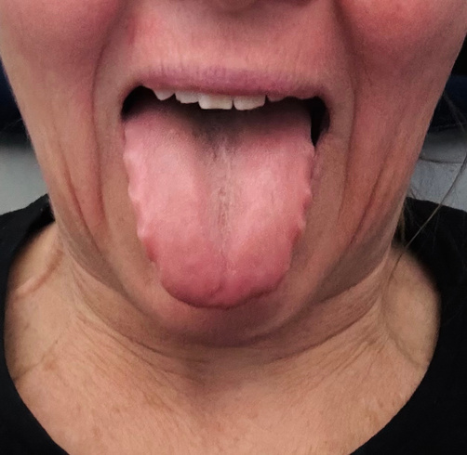
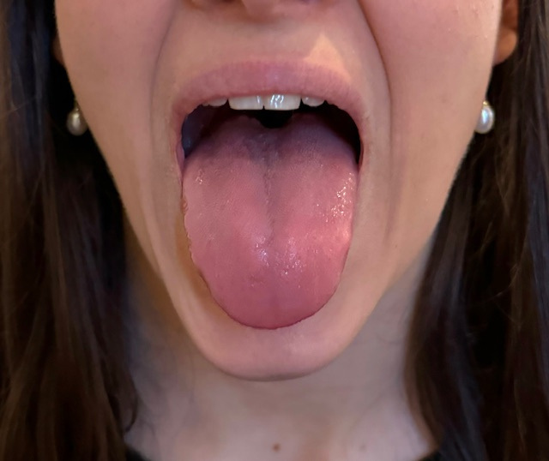
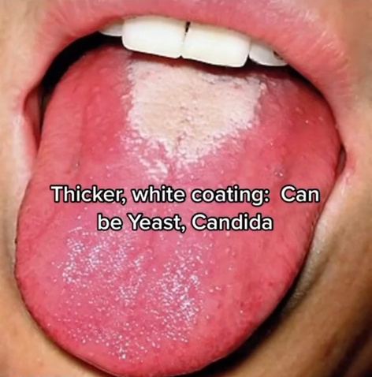
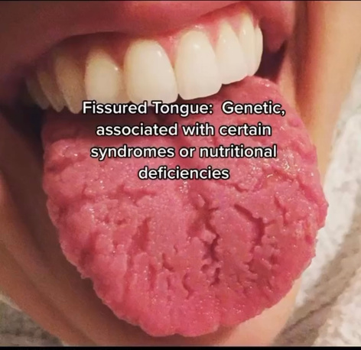
Scalloped Tongue:
The tongue can guide you on what’s happening with nutritional deficiencies, oral biome, and breathing efficiency.
Hypothyroidism
TMJ Disorder
Sleep Disorders
Narrow Palate
Enlarged Tongue
Compromised Lymph Drainage
White Coating
Dehydration
Mouth Breathing
Yeast / Candida
Smoking / Excessive Alcohol
Fissured
Malnutrition
Down Syndrome & Other Syndromes
Psoriasis
Autoimmune Conditions
Healthy Tongue:
Pink, Smooth & Wet
© Dr. Stephen Gangemi – Systems Health Care

Slide 54
Tongue Position
  The tongue provides vestibular (and proprioceptive) input.
  It increases proprioceptive input into the multisensory system.
  As the input from the tongue is integrated, motor neurons become more active. This leads to improved activation of proper motor patterns.
  When the head moves, the tongue is stimulated.
    Stable integration of our sensory system
      e.g., vestibular, visual, tactile, proprioceptive, and auditory
© Dr. Stephen Gangemi – Systems Health Care

Slide 55
Testing for Tongue Position
Using a weak muscle, (ideally a neck muscle), have the patient press their tongue on the roof of their mouth.
80% or more of the tongue should be pressed up – towards the hard and soft palate.
Strengthening of the weak muscle, improved ROM, or decreased pain indicates a need for better tongue position.
© Dr. Stephen Gangemi – Systems Health Care

Slide 56
Tongue Position
Test any weak muscle with proper tongue position
  Common with neck flexors and extensors
Test ROM with proper tongue position
© Dr. Stephen Gangemi – Systems Health Care

Slide 57
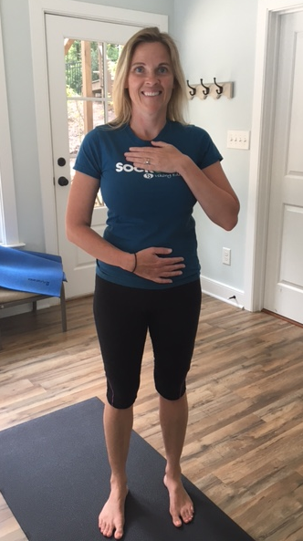
© Dr. Stephen Gangemi – Systems Health Care

Slide 58
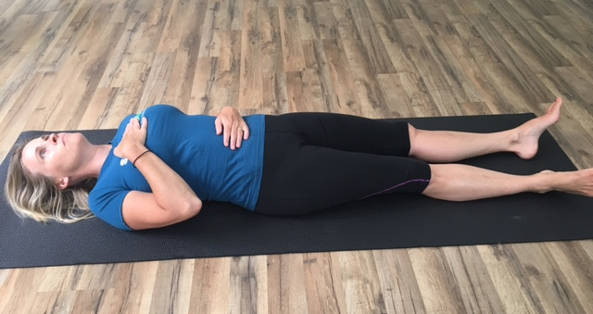
Breathing Positions -1
© Dr. Stephen Gangemi – Systems Health Care

Slide 59
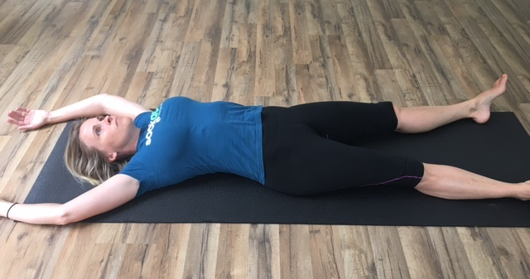
Breathing Positions -2
© Dr. Stephen Gangemi – Systems Health Care

Slide 60
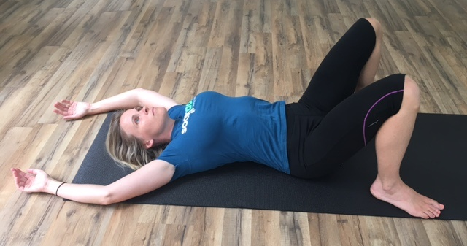
Breathing Positions -3
© Dr. Stephen Gangemi – Systems Health Care

Slide 61
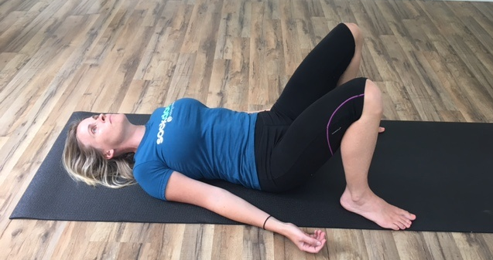
Breathing Positions -4
© Dr. Stephen Gangemi – Systems Health Care

Slide 62
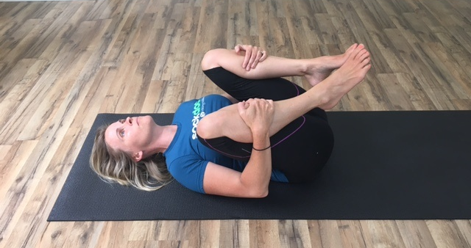
Breathing Positions -5
© Dr. Stephen Gangemi – Systems Health Care

Slide 63
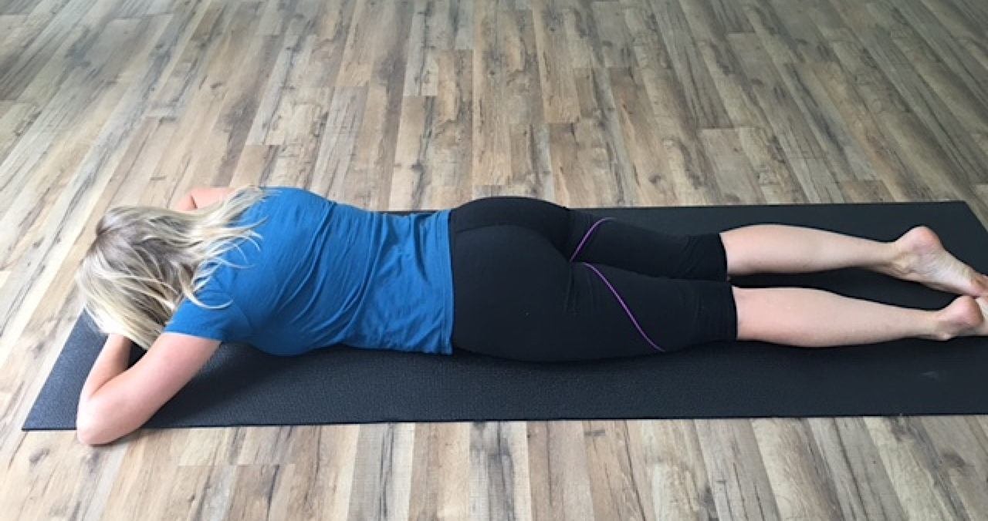
Breathing Positions -6
© Dr. Stephen Gangemi – Systems Health Care

Slide 64
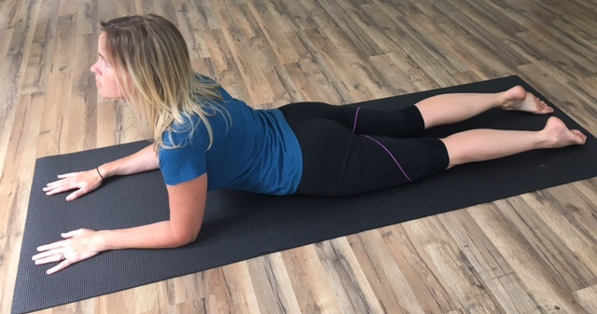
Breathing Positions -7
© Dr. Stephen Gangemi – Systems Health Care

Slide 65
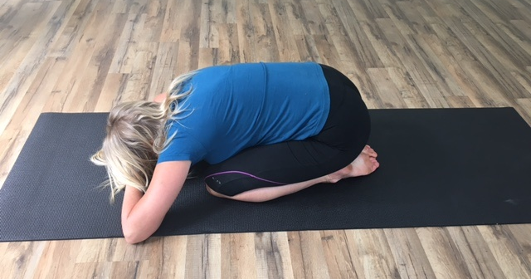
Breathing Positions -8
© Dr. Stephen Gangemi – Systems Health Care

Slide 66
The Longus Colli
The longus colli, a deep neck flexor muscle, has fascial connections to the diaphragm around the level of T8. From the low back and pelvis, the psoas fascial connections extend up to the diaphragm also around T8.
© Dr. Stephen Gangemi – Systems Health Care

Slide 67
Powerful “X”
An “X” is created in the center of the body at the diaphragm.
Longus colli above, psoas below
Forces from movement cross the midline and carry over to the other side at the center of the “X.” The more efficiently these forces can cross, the more powerful and resilient the human body will be.
© Dr. Stephen Gangemi – Systems Health Care

Slide 68
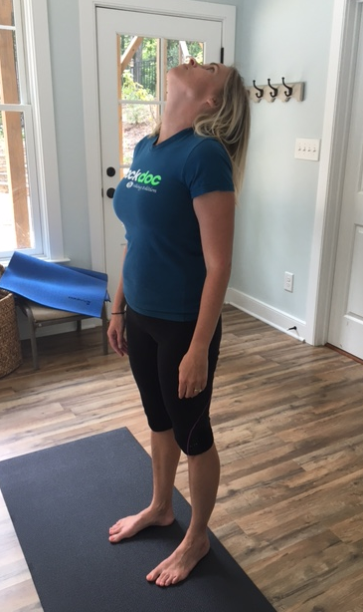
Breathing Positions -9
© Dr. Stephen Gangemi – Systems Health Care

Slide 69
Types of Breathing
Wim Hof Method
Buteyko Method
Box Breathing (Four-square breathing)
Yoga Breathing - Pranayama
Many, many others
© Dr. Stephen Gangemi – Systems Health Care

Slide 70
Many Small Breath Holds
Normal nasal breath in
Normal nasal breath out
Normal nasal breath in
Normal nasal breath out
Pinch your nose and hold for 5 seconds (or ½ of your CP if <10).
Repeat for 4 minutes.
© Dr. Stephen Gangemi – Systems Health Care

Slide 71
Small Breath Holds
Why "Take a Deep Breath" Often Misses the Mark
The Problem
In some states of stress or early respiratory discomfort, large inhalations may increase arousal or reinforce over-breathing patterns.
Supports Early Management Of:
  Anxiety
  Panic attacks
  Dry, irritative cough
  Bronchial "tightness" or early asthma sensations
  Hyperventilation
How Small Breath Pauses Help
• Interrupt rapid or automatic breathing patterns
• Reduce escalation of respiratory drive
• Support a return to calmer nasal breathing rhythm
• Increase tolerance of normal breathing sensations
How to do it:
  Take a normal nasal breath in and out, then hold your breath - pinching the nose 3-5 seconds.
  Rest 10-15 seconds.
  Continue until breathing settles and symptoms subside or seek additional care if warranted.
© Dr. Stephen Gangemi — Systems Health Care

Slide 72
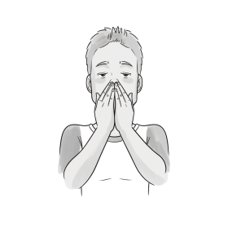
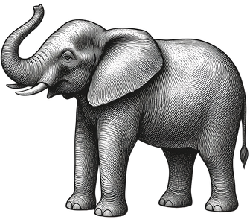
Breathing Exercises: Volume and Rhythm
Elephant Trunk Breathing
Seashell Breathing
Breathe Light & Build CO2 Comfort
Cyclic Stacked Inhale
1. Sit up straight, good posture
2. Cup hands against face with no gaps between fingers
3. Breathe lightly — feel cool air enter and warm air exhaled into hands
4. Cupping pools CO2, increasing what you breathe in
Goal: Soften and lighten breathing to achieve tolerable air hunger. Reduce the size of each breath.
If too intense, slightly open a finger like a seashell opening, then close again when ready.
Benefits: Encourages lighter, reduced-volume breathing and breath awareness, and may support CO₂ tolerance and a calmer breathing pattern.
1. Inhale and pause 1-2 seconds
2. Inhale more and pause 1-2 seconds
3. Keep stacking inhales until you reach your peak
4. Then a smooth relaxing exhale
Goal: To increase awareness and control of the inhale, followed by a prolonged exhale to help regulate breathing and mental state.
Benefits: Promotes gradual lung expansion, may help recruit under-ventilated alveoli, encourages a prolonged exhale, and can support relaxation.
© Dr. Stephen Gangemi – Systems Health Care

Slide 73

Walking While Breathing LIGHT & LOW
  Begin to walk with your mouth closed, correct body posture and tongue posture, lips together, jaw relaxed, while breathing in and out through your nose.
  Place your hands on your lower ribs and see if you can feel the lateral expansion. Walk at a steady pace and breathe as lightly and quietly as you can while still feeling the lower movement of breathing.
*Physical exercise does not improve functional breathing patterns unless it is done while nasal breathing.
Breathe in, feel the ribs move outwards.
Breathe out, feel the ribs move inwards.
Feel your breath.
Walk with postural awareness.
Listen to your breathing.
Consider: running, push ups, squats, cross crawl,
and other exercises
Nasal breathe as lightly as possible with your tongue up!
© Dr. Stephen Gangemi – Systems Health Care

Slide 74
Breath Holds to Load the Diaphragm
Paces: Holding your breath after an exhale places additional strain on the diaphragm which can strengthen it.
  Start by walking with your mouth closed, keeping your jaw relaxed and tongue on the roof of your mouth. Ensure controlled breathing throughout the exercise. Inhale and exhale through your nose, then pinch your nose and take 5 steps before releasing and resuming nasal breathing.
  Continue walking for 30-60 seconds.
(5, 5, 5, 10, 10, 10, 15, 15, 15, 20, 20, 20, 25, 25, 25...30, 30, 30, 35, 35, 35...)
*If feeling unwell, prone to panic, have high blood pressure, or a BOLT Score of less than 10 seconds, do not exceed 10 paces.
© Dr. Stephen Gangemi – Systems Health Care

Slide 75

Eye Lift Reflex
1. Keep your chin and head still.
2. Tip your eyes back as far as possible.
3. Keep your eyes wide open and try not to blink.
4. Hold this for a count of 15 seconds and then close your eyes.
A Buteyko technique which helps with anxiety, reduced volume breathing, and a reset for the diaphragm
Finger on the chin helps prevent your head from tipping back.
© Dr. Stephen Gangemi – Systems Health Care

Slide 76
Tape Your Mouth Shut? – Get an Integrative Breathing Assessment
Myotape
Sleep Improvement
Apnea
Hydration
© Dr. Stephen Gangemi – Systems Health Care

Slide 77
Breathe Well…
…as Often as Possible.
It’s Free.
© Dr. Stephen Gangemi – Systems Health Care

Slide 78
More Learning:
Oxygen Advantage – Patrick McKeown
Breath – James Nestor
The Breathing Cure – Patrick McKeown
© Dr. Stephen Gangemi – Systems Health Care

Slide 79

“Breathe through your mouth as much as you want to eat through your nose.” – Dr. Buteyko
Photo by Richard Jacobs on Unsplash
© Dr. Stephen Gangemi – Systems Health Care

Slide 80



Thank you!
Where to find me for any questions or to learn more:

